Slide 1
Researching Recent California Regulations
NOCALL SPRING INSTITUTE - APRIL 1, 2017
CHUCK MARCUS
UC HASTINGS COLLEGE OF THE LAW LIBRARY
marcusc@uchastings.edu

Slide 3
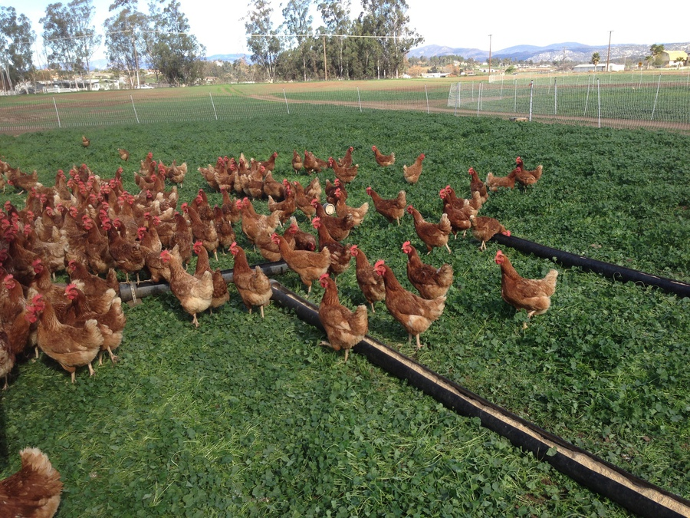
Researching Recent California Regulations
Definitions
Research Tools from the CA government (OAL)
Research Tools from Agencies and private sector
Research the SEFS (Shell Egg Food Safety) Regulation

Slide 4
Definitions
CA Gov’t Code sec 11342.600 “Regulation” means every rule, regulation, order, or standard of general application or the amendment, supplement, or revision of any rule, regulation, order, or standard adopted by any state agency to implement, interpret, or make specific the law enforced or administered by it, or to govern its procedure.

Slide 5
Definitions
CA Gov’t Code sec 11342.600 “Regulation” means every rule, regulation, order, or standard of general application or the amendment, supplement, or revision of any rule, regulation, order, or standard adopted by any state agency to implement, interpret, or make specific the law enforced or administered by it, or to govern its procedure.

Slide 6
Definitions
Govt.C. 11342.1. A regulation is ordinarily invalid unless it falls within the scope of authority conferred on the agency by statute.
Govt.C. 11342.2 A regulation adopted pursuant to statutory authority, express or implied, is not valid or effective “unless consistent and not in conflict with the statute and reasonably necessary to effectuate the purpose of the statute.”

Slide 7
Definitions
Govt.C. 11342.1. A regulation is ordinarily invalid unless it falls within the scope of authority conferred on the agency by statute.
Govt.C. 11342.2 A regulation adopted pursuant to statutory authority, express or implied, is not valid or effective “unless consistent and not in conflict with the statute and reasonably necessary to effectuate the purpose of the statute.”

Slide 8
Definitions
Govt.C. 11342.1. A regulation is ordinarily invalid unless it falls within the scope of authority conferred on the agency by statute.
Govt.C. 11342.2 A regulation adopted pursuant to statutory authority, express or implied, is not valid or effective “unless consistent and not in conflict with the statute and reasonably necessary to effectuate the purpose of the statute.”

Slide 9
Definitions
The Office of Administrative Law is required to provide for the official compilation, printing, and publication of adoption, amendment, or repeal of regulations in the California Code of Regulations.
Internet Publication. The Office of Administrative Law must make available on the Internet, free of charge, the full text of the California Code of Regulations

Slide 10
Definitions
The California Regulatory Notice Register is published weekly, and contains the following:
Notices of proposed action.
A summary of all regulations filed and all regulation decisions issued in the previous week.
Agencies' annual rulemaking calendars.
Agency decisions on petitions requesting adoption, amendment, or repeal of regulations.

Slide 11
Tools at Hand
From the OAL:
California Code of Regulations
California Code of Regulations Supplement
California Regulatory Notice Register
Digest of New Regulations

Slide 12
Tools at Hand
California Regulatory Law Bulletin (Barclays on Lexis 1995- )
A Contact at the CA Agency
CA Agency Website
Westlaw (NetScan 2006- )
Lexis (StateNet 2000- )
Google Advance Search
Wayback Machine at the Internet Archive
Research Guides from Academic Law Libraries

Slide 13
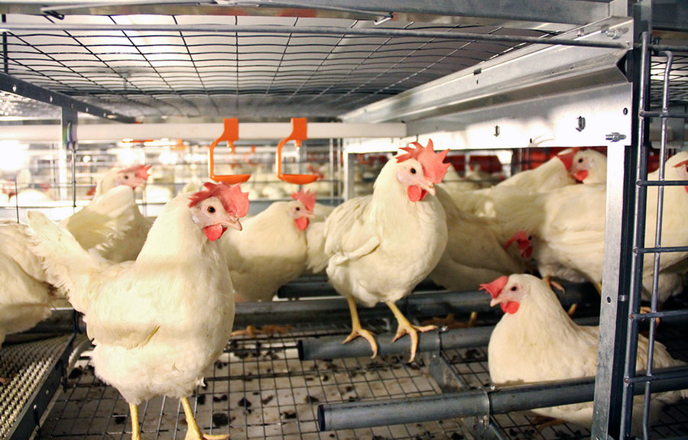
CA Shell Egg Food Safety Compliant
Proposition 2 (2008)
AB 1437 (2010)
CA Department of Food and Agriculture
Animal Health and Food Safety Services Division
Egg Safety Rules
Missouri v. Harris

Slide 14
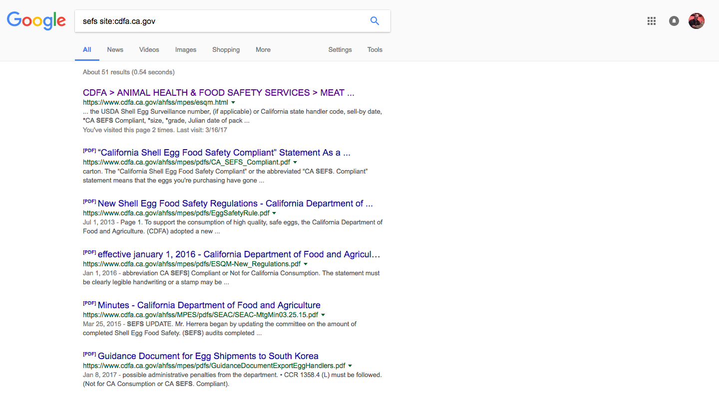

Slide 15
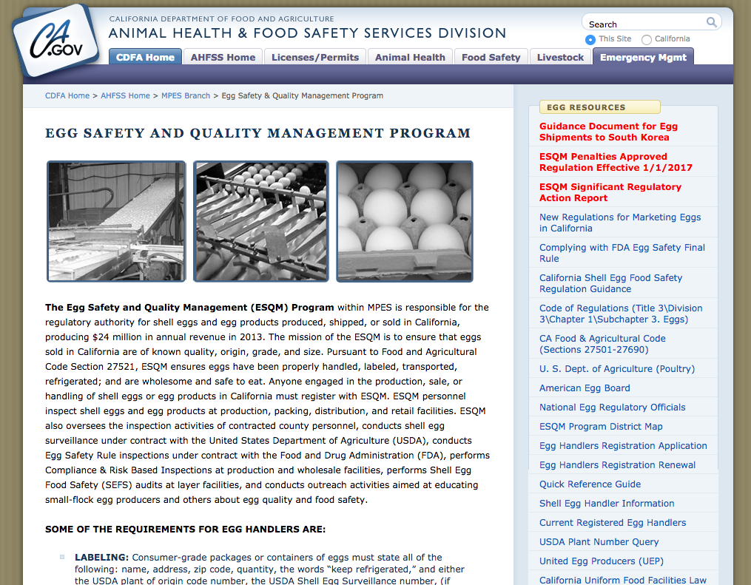
Current Agency Website

Slide 16
Current Agency Website
3 CCR 1350, 1354

Slide 17
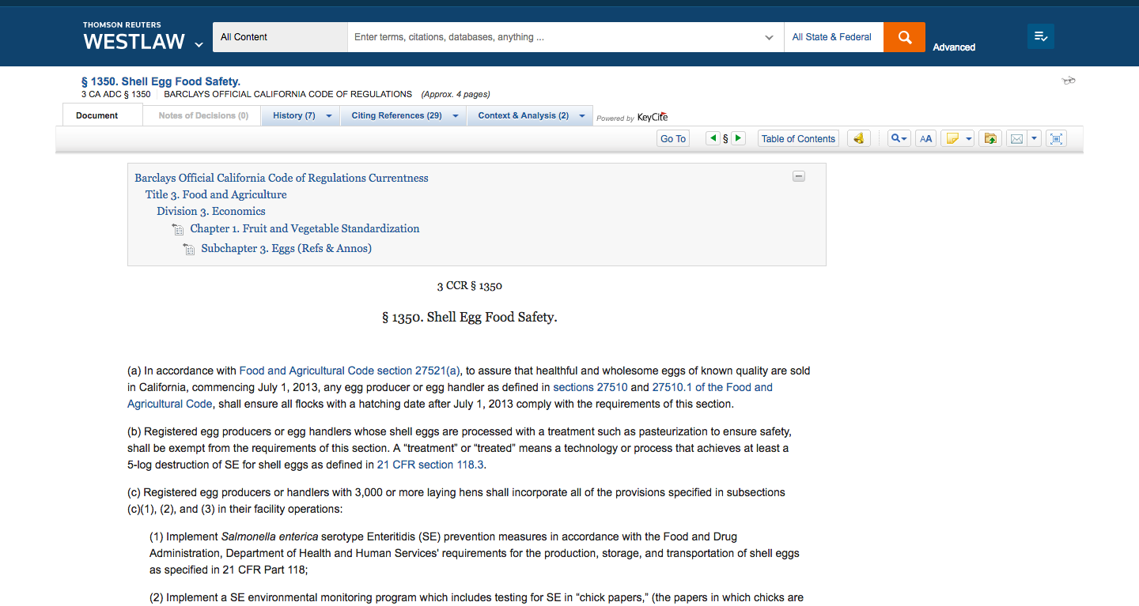

Slide 18
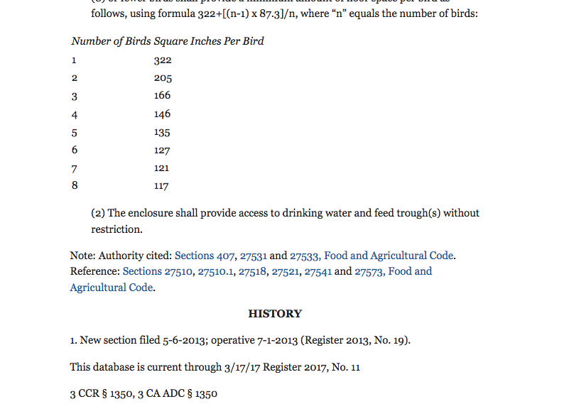

Slide 19
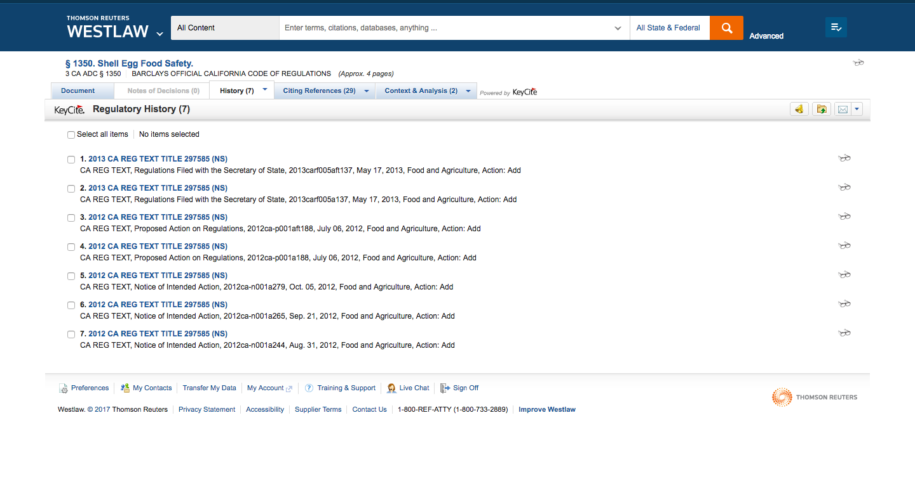

Slide 20
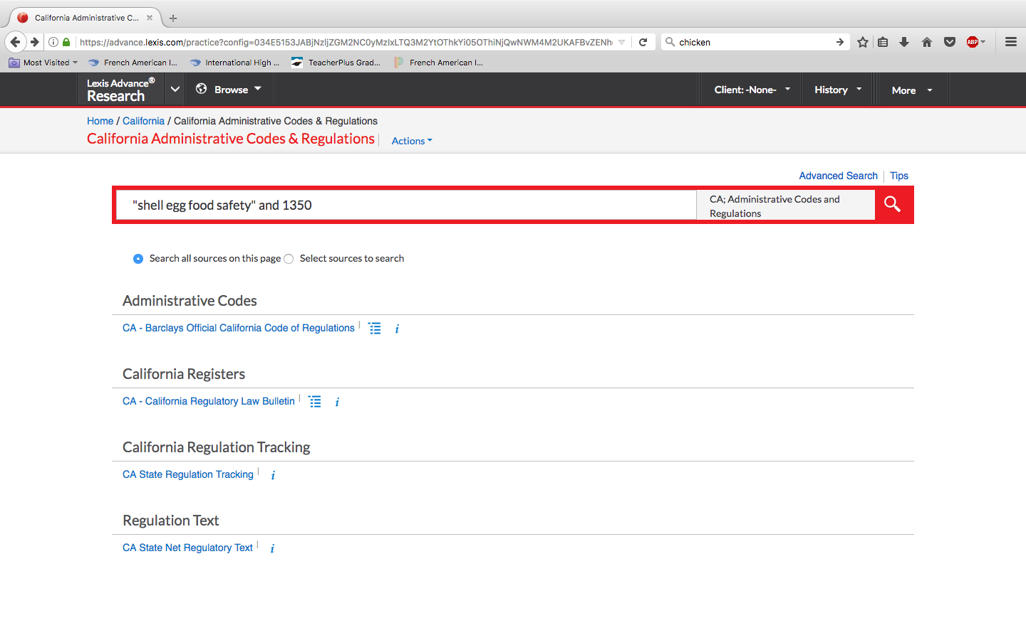

Slide 21
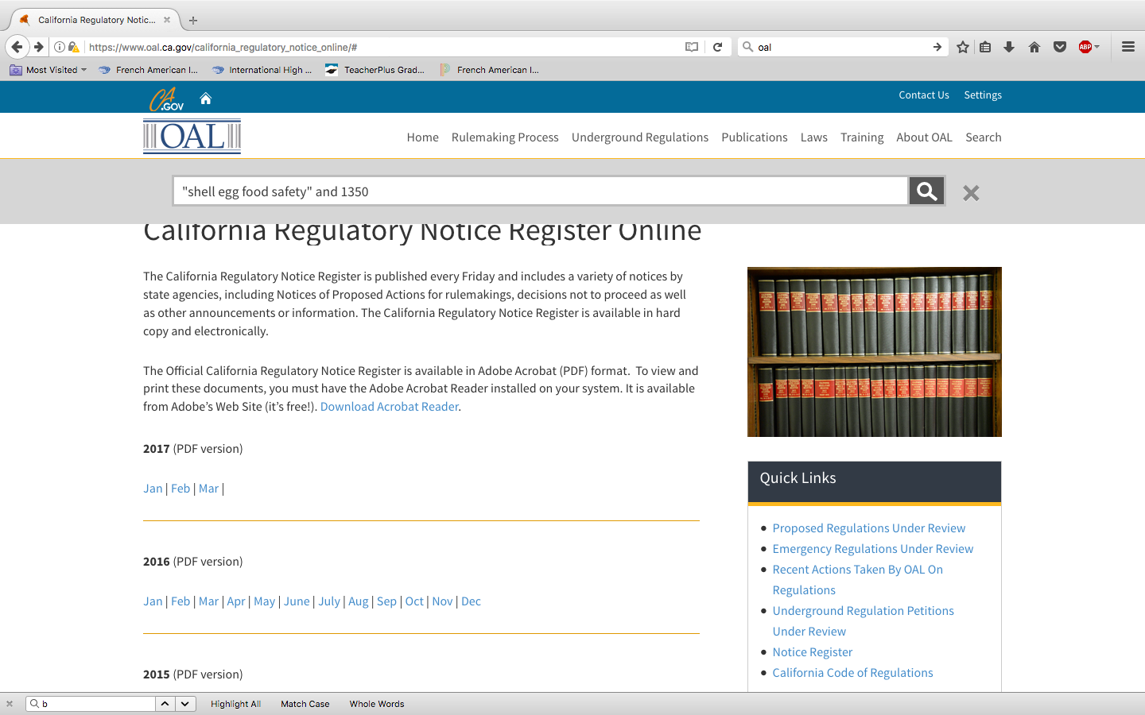

Slide 22
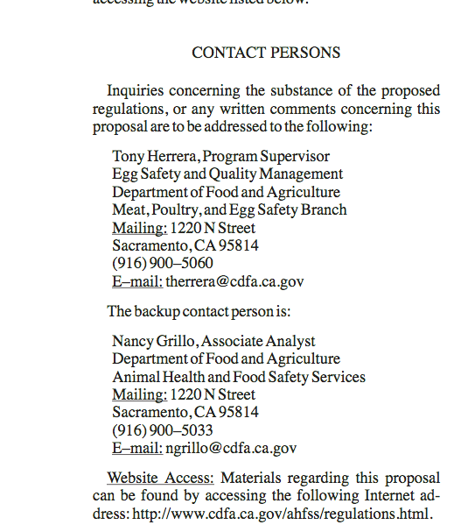
Tools at Hand
Agency Contact
CALIFORNIA REGULATORY NOTICE REGISTER 2012, VOLUME NO. 27-Z
Final Statement of Reasons
& Rulemaking File

Slide 23
Tools at Hand
Agency Contact
CALIFORNIA REGULATORY NOTICE REGISTER 2012, VOLUME NO. 27-Z
Final Statement of Reasons
& Rulemaking File

Slide 24
Tools at Hand
Notes:
Legislative History of empowering statutes
Filings and briefs on PACER for Missouri v. Harris

Slide 25
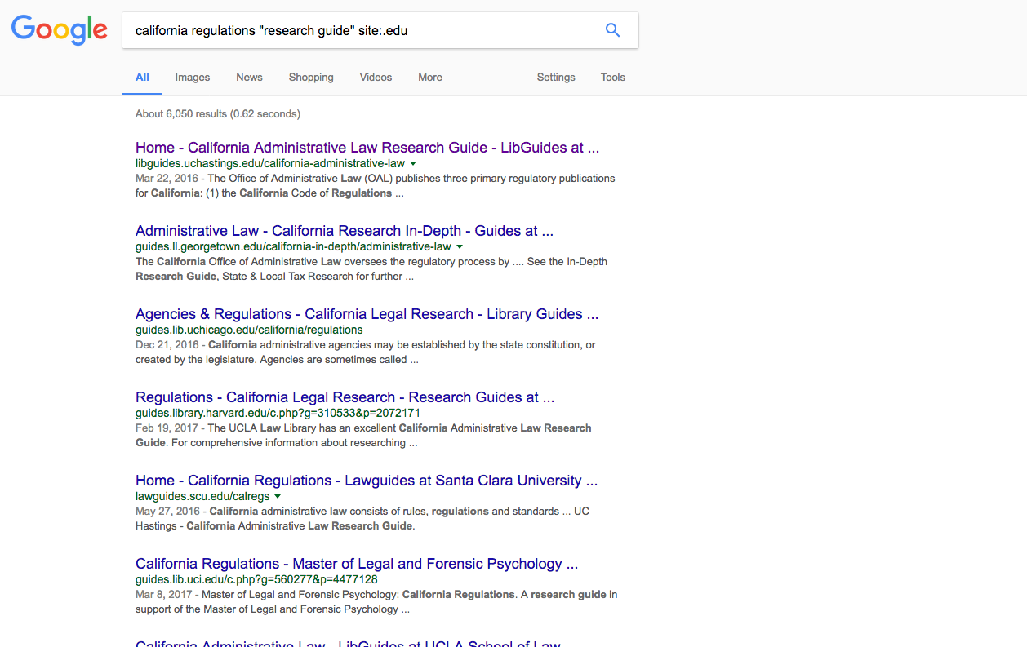

Slide 26
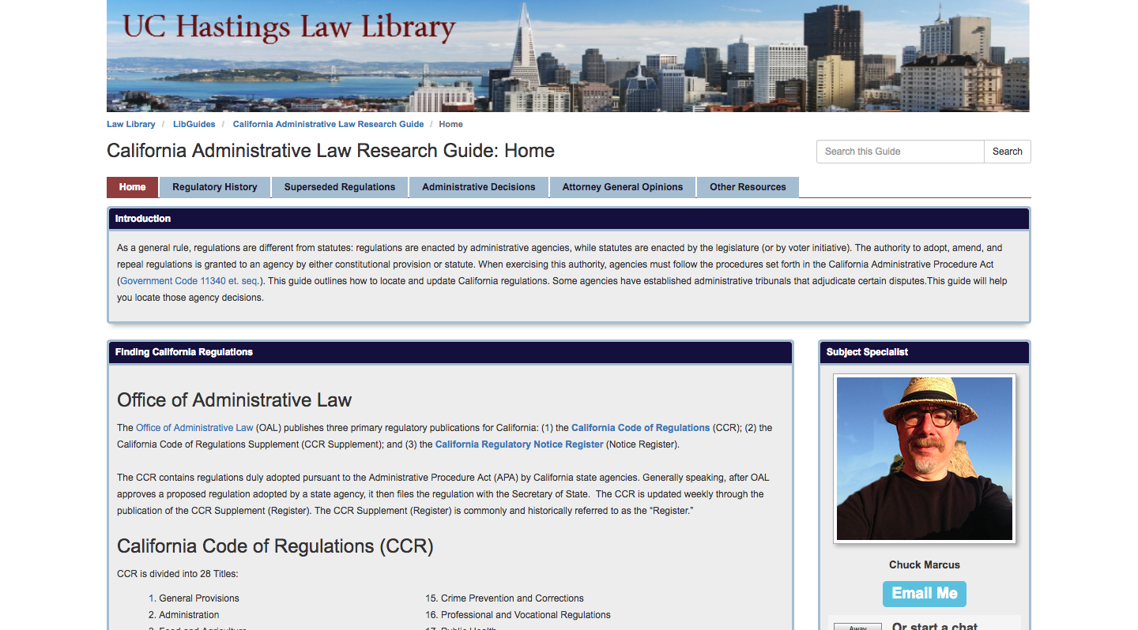

Slide 27
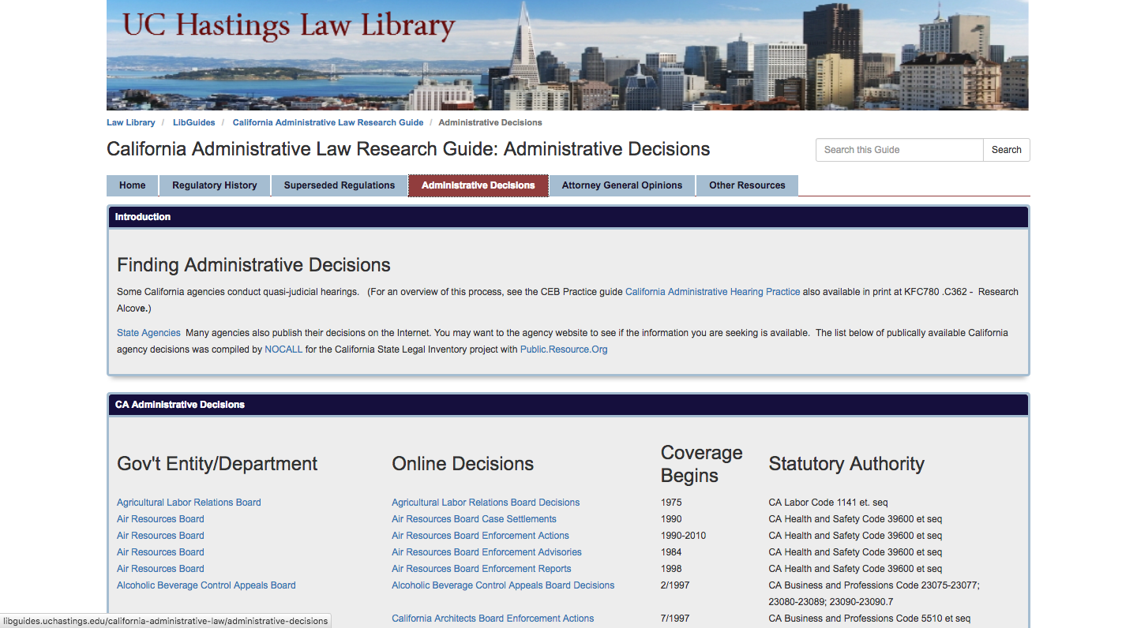

Slide 28
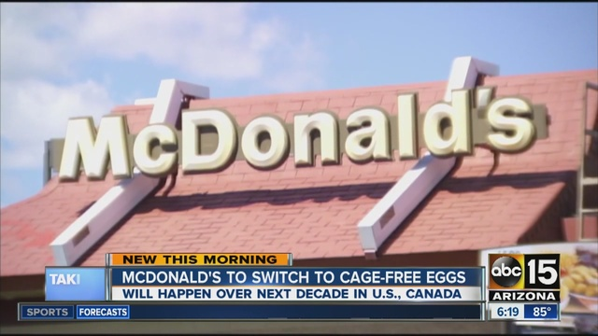

Slide 29
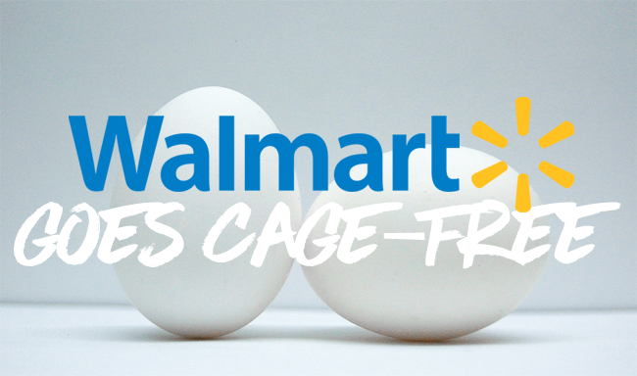

Slide 30
Further Reading on Regulations
9 Witkin, Cal. Proc. 5th ed., Admin Proc § § 1-56
2 Cal. Jur. 3d Administrative Law § § 1-378
Daniel W. Martin, Henke’s California Law Guide 8th ed., § § 8.01-8.07

