Slide 1
Why LegalTech is not Disrupting the Legal Industry – or, is it?
NOCALL Meeting
Redwood City
Roland Vogl
Stanford Law School
January 19, 2017

Slide 2
J. Paul Lomio

Slide 3
Notes:
What is CodeX?:
-Stanford Research Center
-Innovation Network
Our Mission:
-Research and Develop Technologies that Make the Legal System More Efficient

Slide 4
Overview
The Disruptive Innovation Discourse in Legal
The Gap between the Rhetoric and Reality
Legal Automation, Legal Prediction and the Specter of the Robolawyer
Innovation Diffusion and Innovation Model Choice in Legal

Slide 5
Part 1
The Disruptive Innovation Discourse in Legal

Slide 6
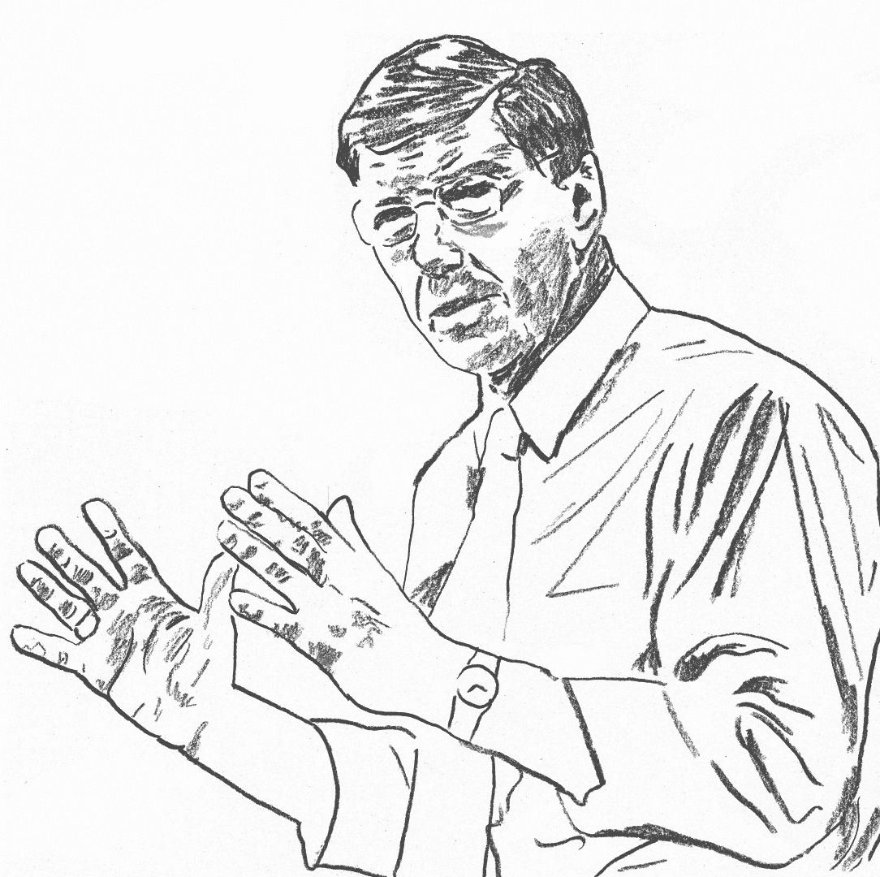
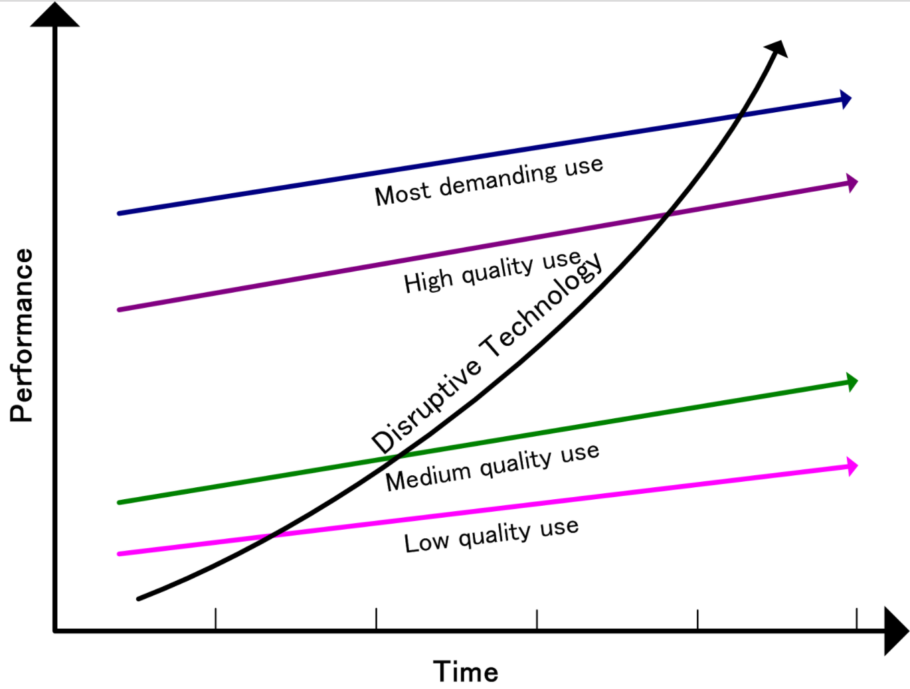
What’s Disruptive Innovation?
Disruptive innovation is a process by which a product or service takes root initially in simple applications at the bottom of a market and then relentlessly moves up market, eventually displacing established competitors.
Critique: Term is used
in a loose and murky manner, has become cliché.
Wikipedia
Clayton Christensen

Slide 7
How Disruption Works
Incumbents innovate with incremental improvements to the quality of product/service. Focus is on sustaining the business model.
Quality
Incumbents: sustaining innovations
Minimum customer need
Time
Disruptors create new products or services, often low quality, that are initially not a threat in the market.
Quality
Minimum customer need
Disruptive innovations
Time
Over time, disruptors improve the product/service with new technology. The flash-point comes when their product/service becomes “good enough” for most customers
Quality
Minimum customer need
Time
2014 Innovation Report, The New York Times

Slide 8
Notable Disruptions
Notable Disruptions
Cell phones
DISRUPTED
Digital cameras
Online music
Movie rentals
Car service

Slide 9
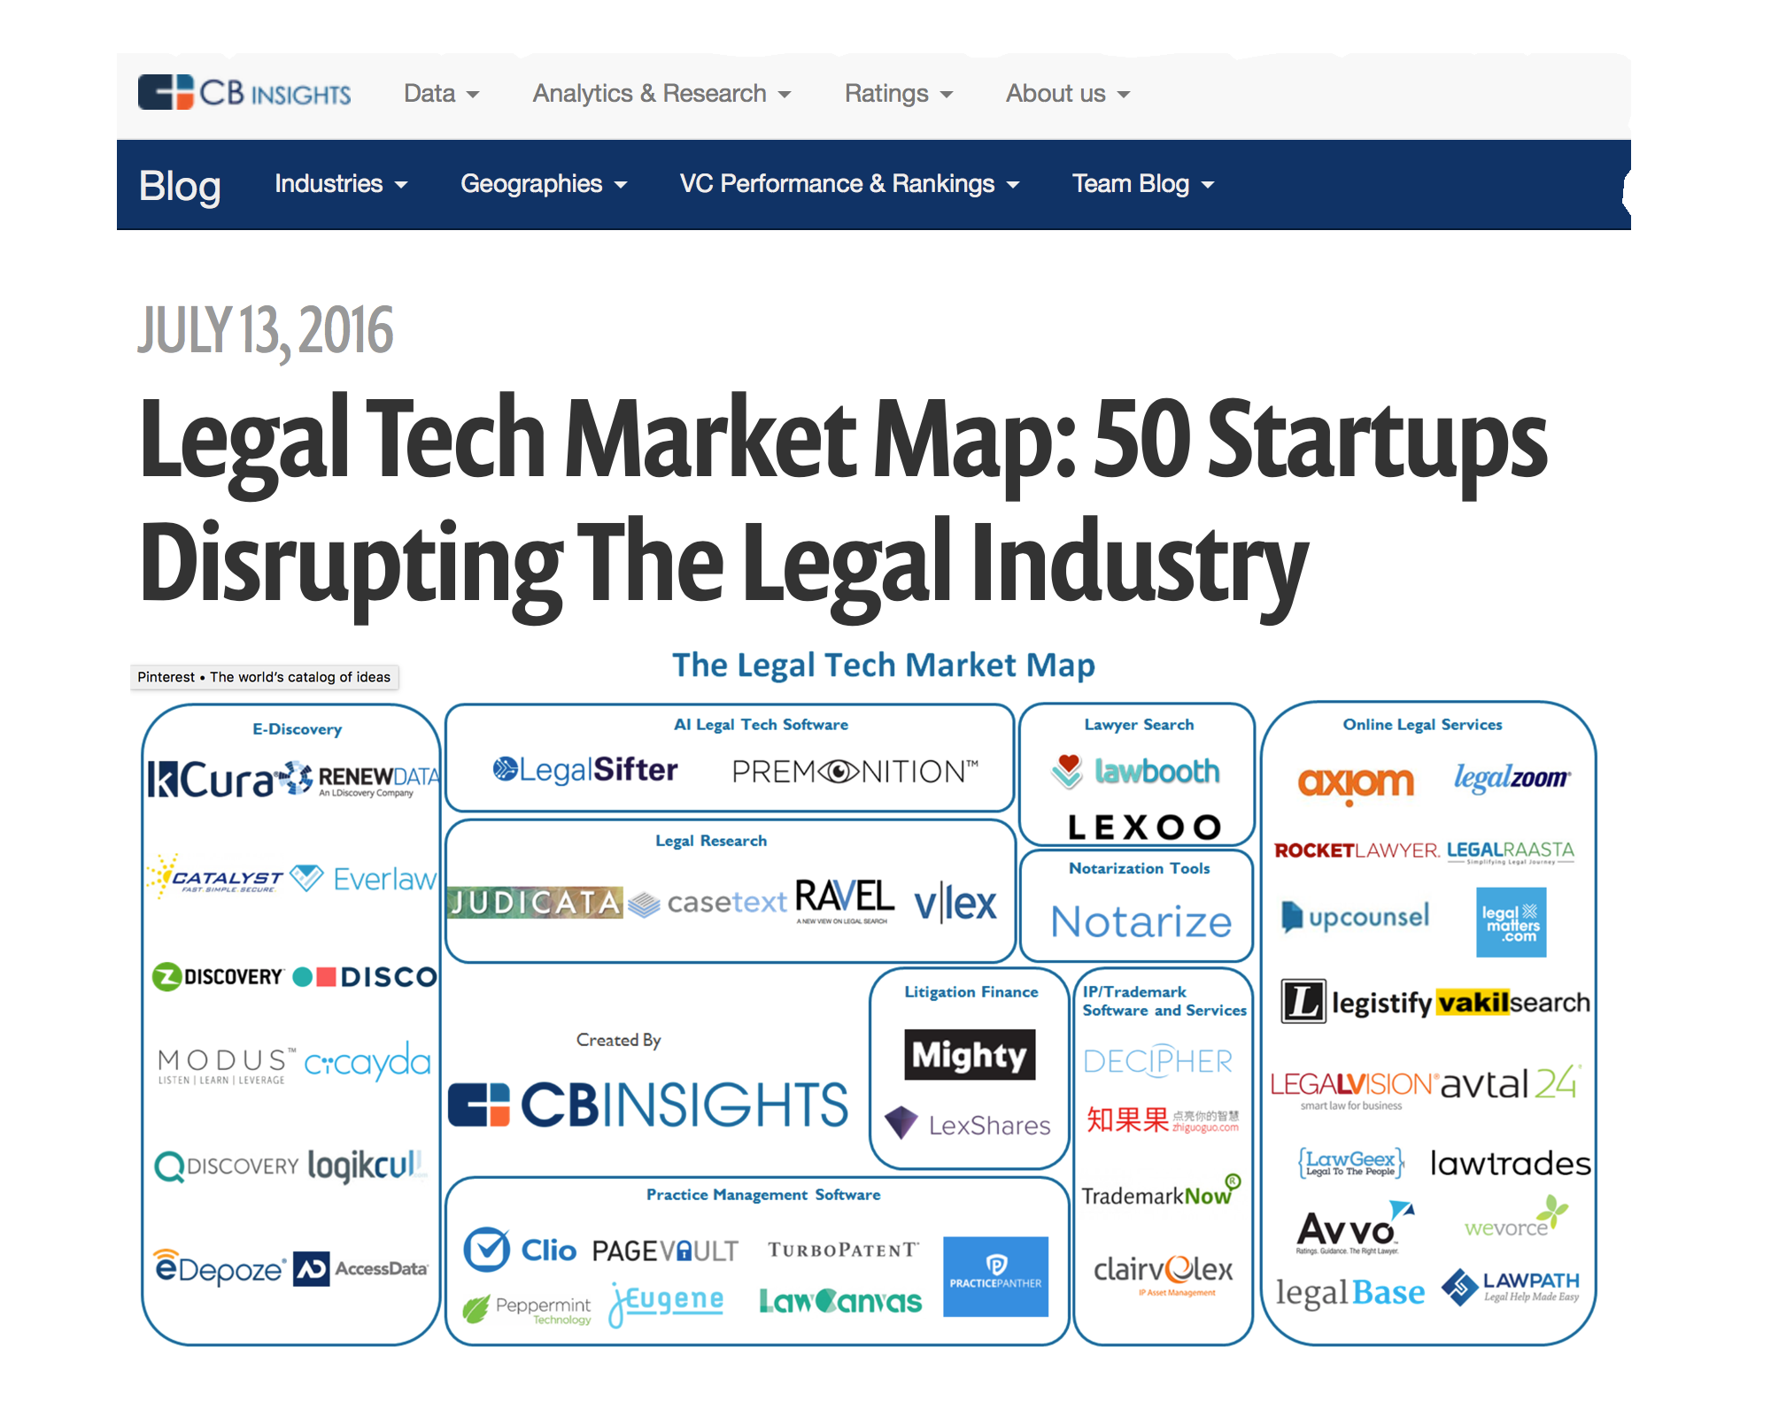
The Disruptive Innovation Rhetoric in Legal

Slide 10
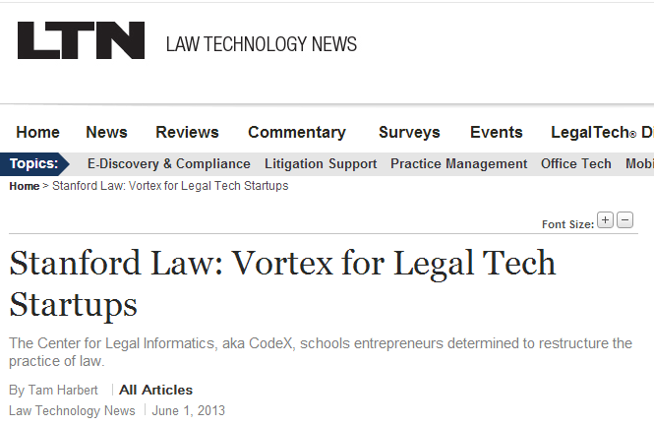
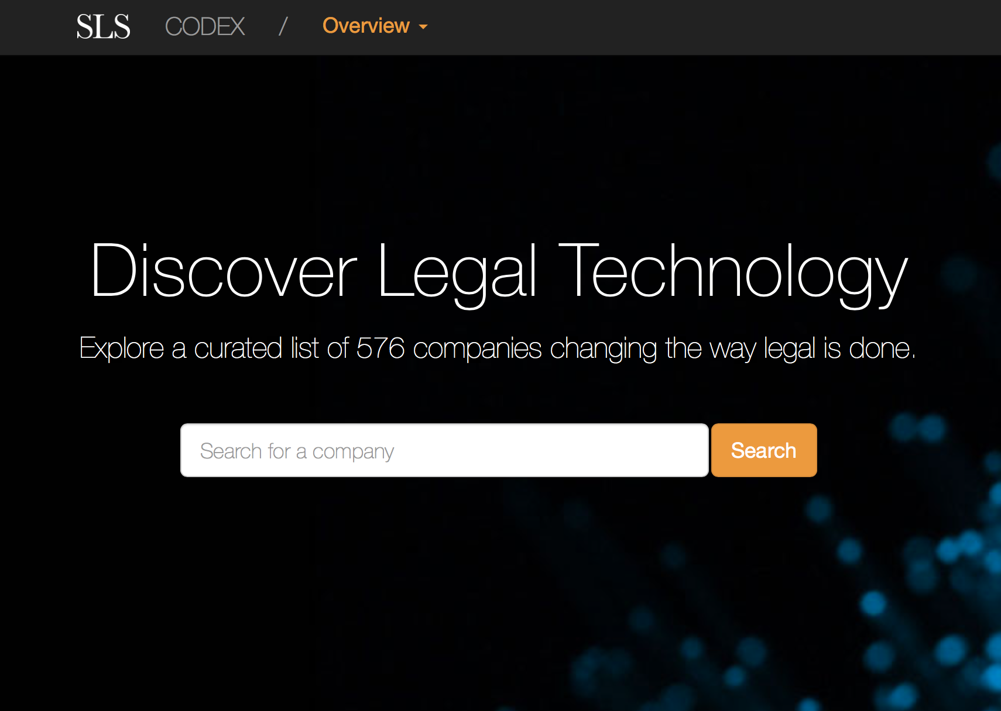
The Disruptive Innovation Discourse in Legal

Slide 11
Part 2
The Gap between the Disruption Rhetoric and Reality

Slide 12
The Gap between the Disruption Rhetoric and Reality
The U.S. Legal System Circa 2016…
Unhappy clients and lawyers
A2J Crisis
Courts backlog
Question: Is there a Disruption, Incremental Change, or No Change?

Slide 13
Why?
Why Legal Should be Ripe for Disruption
Why It’s Not happening
Law is a system that is inherently change-resistant
Law firm structure (Why Rock the Boat?)
Billable hour
Gatekeeping Regulations (UPL, Rule 5.4)
Power shift to clients
Unbundling of legal tasks
Clients are insourcing legal work
Alternative Legal Service Providers
LegalTech Start-up Boom
Online accessibility of law, Moore’s Law, Watson..

Slide 14
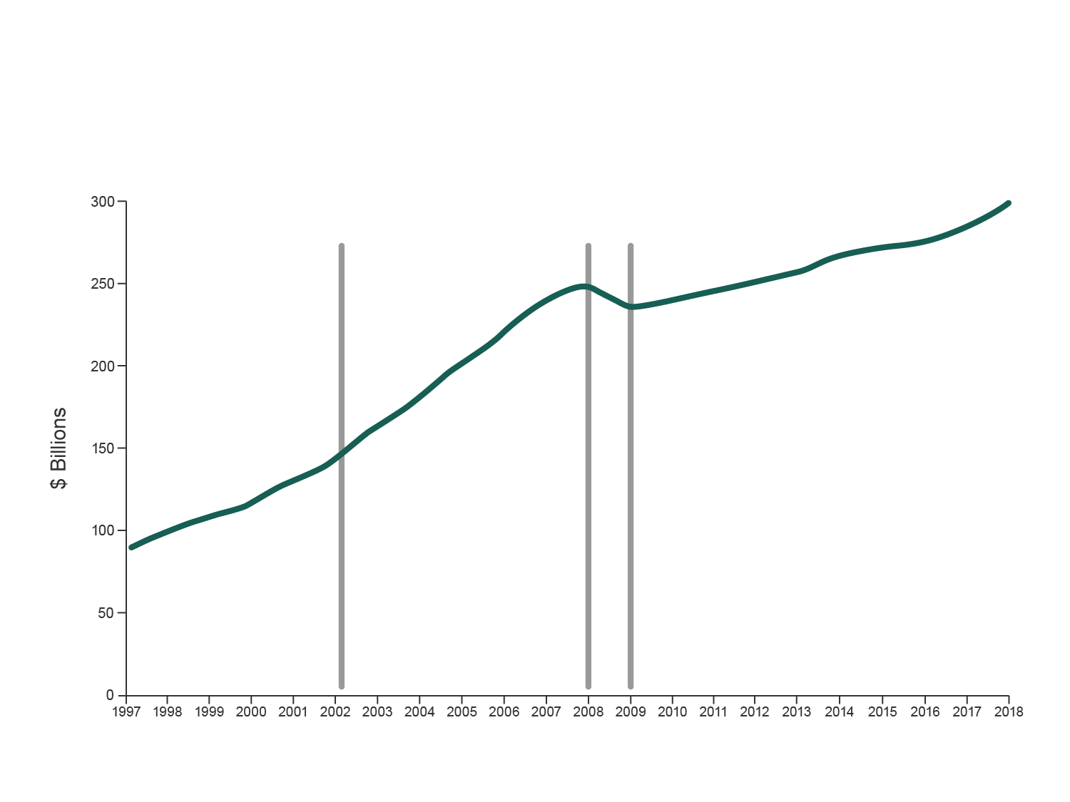
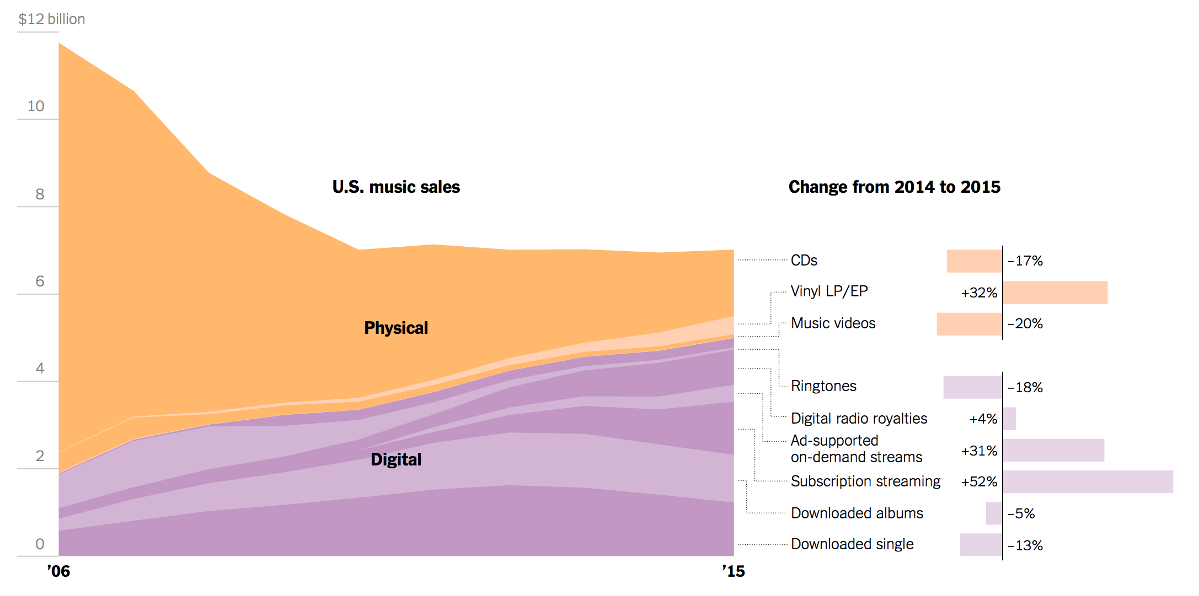
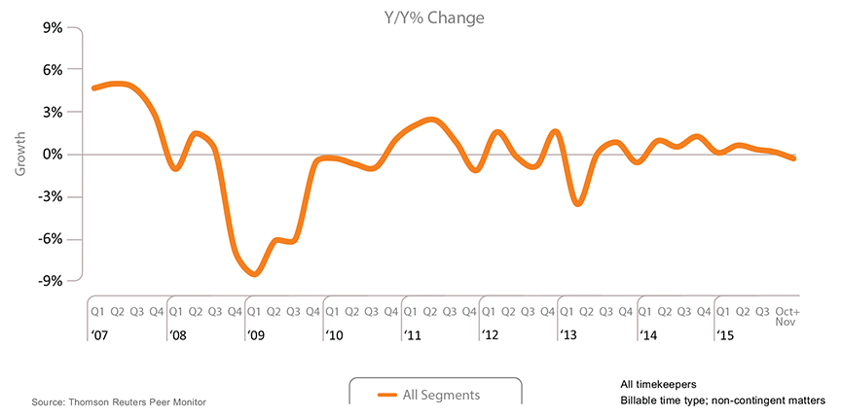
Music Industry Disruption vs. Flat Growth of Law Firm Revenues

Slide 15
Law Firms Changing Pricing Strategy
Only 1/3 of law firms are introducing changes: Alternative Fee Structures, tracking data re cost, Price Director, Discounts,…
All Law Firms
Large vs. small firms
57% Firms with 250+ Lawyers that are changing pricing strategy
2016 “Law Firms in Transition” (Altman Weil Flash Survey)
Notes:
In March and April 2016, Altman Weil surveyed 800 Managing Partners and Chairs of 800 US Law Firms with more than 50 lawyers. 45% response rate.

Slide 16
Efficient Delivery of Service
Knowledge Management, Project-Management, Reengineering of Work Processes
44% of all firms are introducing changes
30%
thinking about it
2016 “Law Firms in Transition” (Altman Weil Flash Survey)

Slide 17
The Gap between the Disruption Rhetoric and Reality
Why Should we care?
Disruption talk without real change in the industry enables complacency => cements the status quo
Understanding how innovation spreads in legal helps identify and remove barriers to change => faster, better, cheaper (fairer) legal system

Slide 18
Part 3
Legal Automation, Legal Prediction and the Specter of the Robolawyer

Slide 19
Tech Innovation Is Growing in Importance
Search
Big data
Computational Law/Expert Systems
Practice Management
ODR

Slide 20
Phases of Innovation in Legal
(Prof. Oliver Goodenough)
1
Technology empowers people within the current system
.0
2
Technology replaces an increasing number of people within the current system
.0
3
Technology results in a radical redesign or full replacement of the current system.
.0

Slide 21
The Future of the Professions
(Richard and Daniel Susskind’s new book)
Scenario 1 Familiar changes: |  | Standardize and systematize routine activities |  | Streamline old ways of working
Scenario 2 Radical changes: |  | Transformation in the way that the expertise of professionals is made available in society |  | Capable systems will displace traditional work
Short to medium term both scenarios develop in parallel
Long term – Scenario 2 will dominate

Slide 22
Commoditization of Legal Services and Legal Automation
Do you think that commoditization of legal services is a permanent trend?
88% Permanent Trend
Commoditization is a stepping stone towards legal automation
2016 “Law Firms in Transition” (Altman Weil Flash Survey)

Slide 23
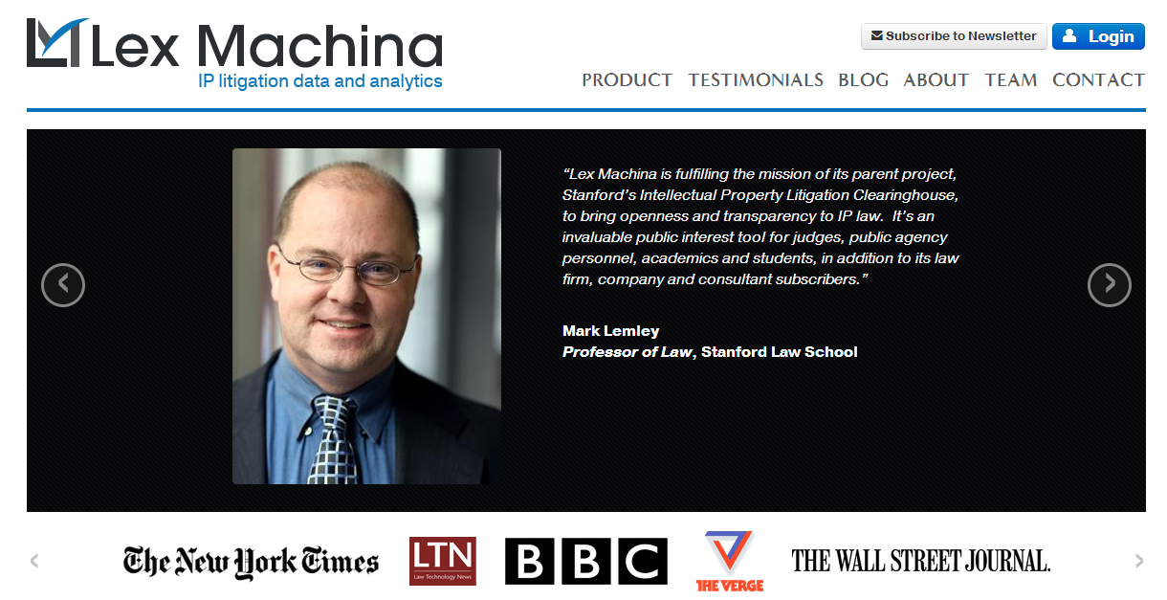
The Specter of the Robolawyer
Cognitive decision making aspects of technology is the most worrisome for lawyers
Legal Process Automation (e.g., Turbotax, Computable Contracts); enabled by
Explicit representation of law in computable form (computable law)
Predicting Legal Outcomes (big data law); enabled by
Statistical AI
NLP
Machine learning

Slide 24
Automation Research: Analyzing Work Activities Rather than Occupations

Slide 25
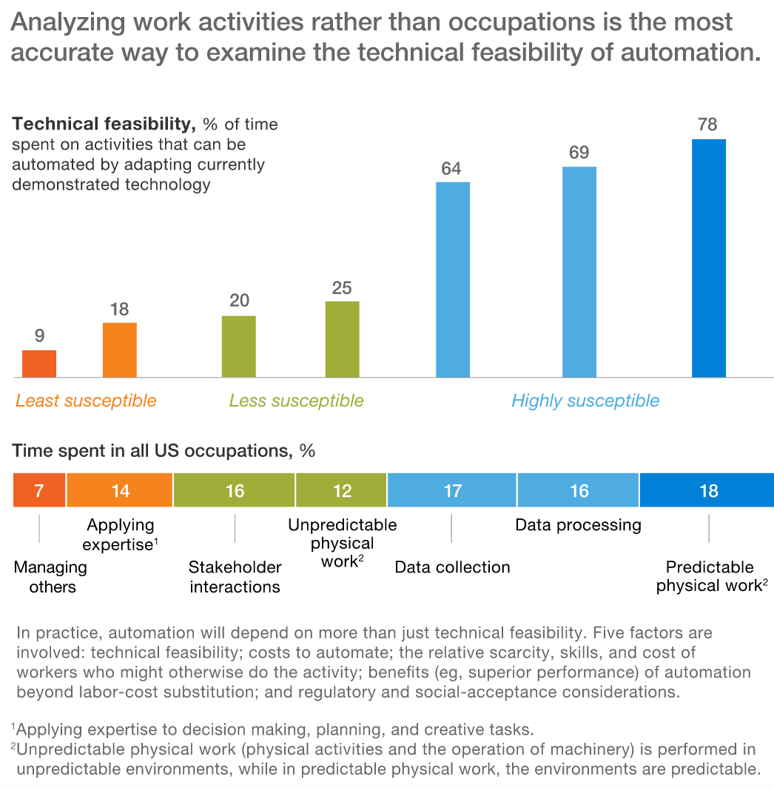
Analyzing 2,000-plus work activities for more than 800 occupations. Using data from the US Bureau of Labor Statistics and O*Net

Slide 26
Automation Through LegalTech:
Technical Feasibility - AI winter
Cost to Automate - Expert Systems
Relative scarcity, skills and cost of workers who might otherwise do the activity - LPO
Benefits of automation beyond labor cost substitution - Big data law
Regulatory, and social acceptance considerations - UPL, empathy (can AI substitute of EI)

Slide 27
Part 4
Innovation Diffusion and Innovation Model Choice in Legal

Slide 28
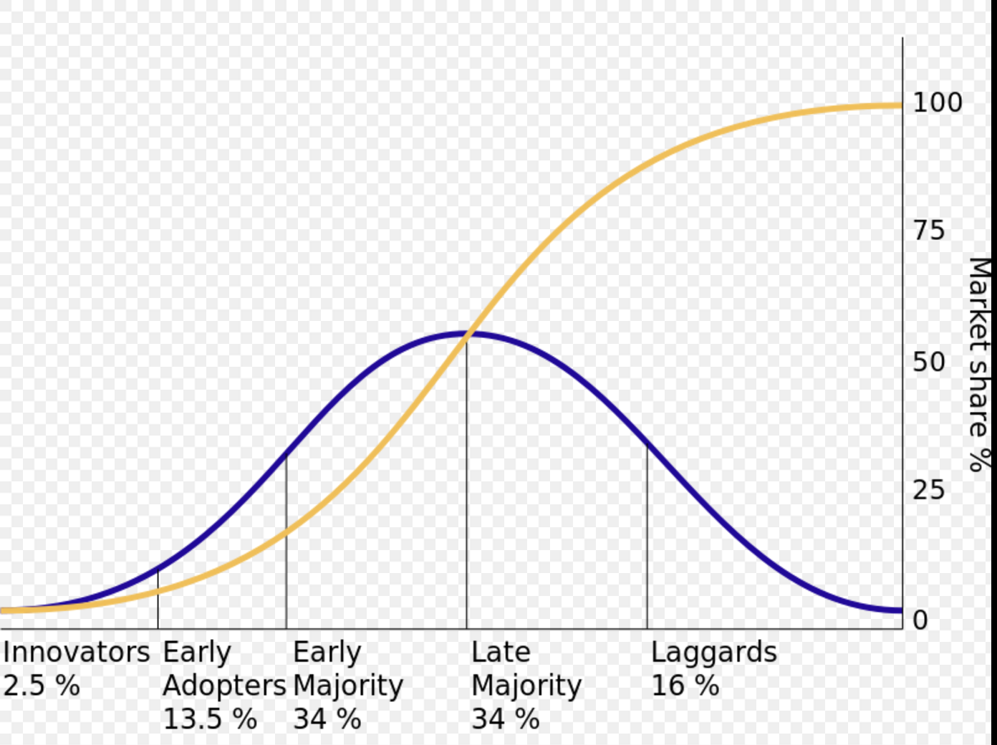
How Innovations Spread - Classic View
Innovation Diffusion Theory
Wikipedia

Slide 29
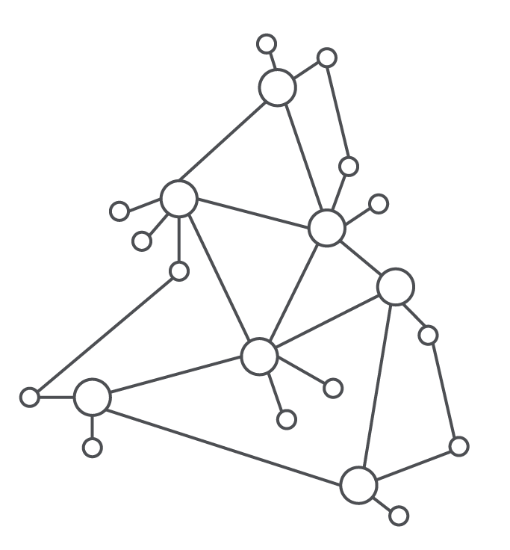
How Innovations Spread – Modern View
Complex Networks

Slide 30
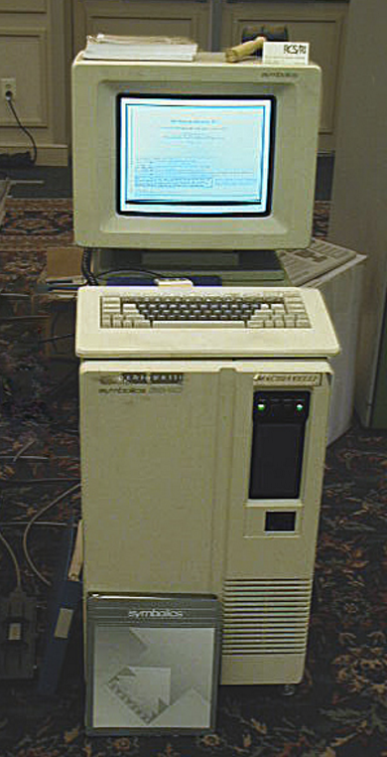
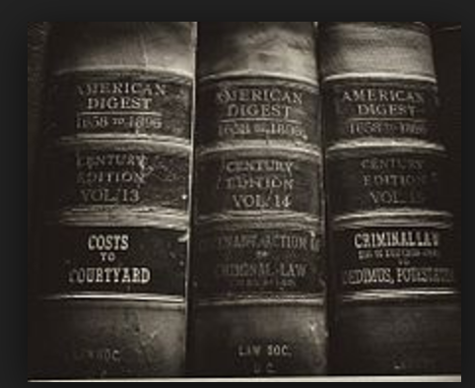
Disruptive Innovations or Incremental Change?
’00 | ’10 | ’20 | ’30 | ’40 | ’50 | ’60 | ’70 | ’80 | ’90 | ’00 | ’10
➤ Computational Law/Computable Contracts/Blockchain
➤ Big Data Law
➤ Alternative Legal Service Providers
➤ Multisided Platforms (MSPs)/Attorney Networks
➤ Legal Process Outsourcing
➤ Ediscovery
➤ Expert Systems
➤Electronic Research
➤West’s American Digest System
1900
Present Day
2000

Slide 31
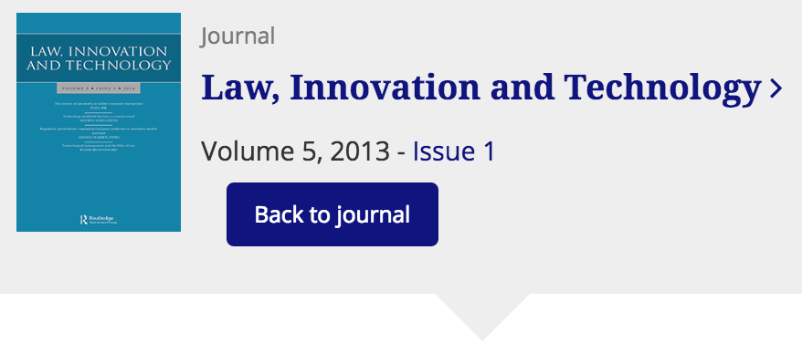
Central Argument: | Type of innovation model deployed matters, especially when concerned about external constituents

Slide 32
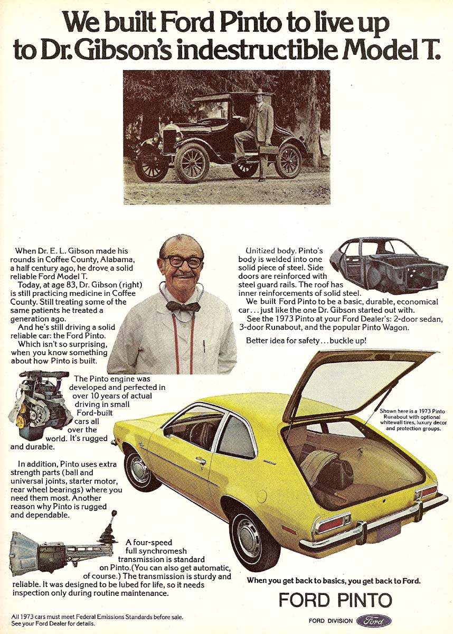
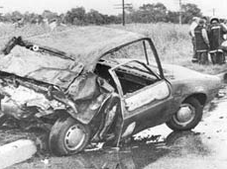
Problem
Edgell Vogl Stanford
Information Terms:
“indestructible”
“extra strength parts”
“reinforced with steel”
BENEFIT
← Firm external constituents →
HARM
Contemporary Innovation Harm:
Global financial markets’ collapse (Demyanyk & Van Hemert, 2009; Stiglitz, 2010)
Air France and Airbus (Bureau d’Enquêtes et d’Analyses (BEA) 2009)
Other empirical cases (see paper)
GAP
Harm
Innovation
Fuel efficiency
Low purchase price
Design flaw – gas tank
No mitigating action
Research Question:
Under which circumstances are innovating firms most likely to create harm?
Innovation = path creation—trajectory??
Legal Literature Cases: Sometimes
Innovation = negative outcomes
Information was critical variable
Illustrative, well documented = Ford Pinto
Methods:
Interdisciplinary literature review (cases, etc.)
Content analysis (28 models) for typology
Innovation Literature Assumption:
Innovation = positive outcomes
1971-1976 Pinto gas tank fires:
27 died & 24 injured

Slide 33
Innovation Model and “Bottom of the Legal Market” Innovation
Reset consumer expectations re price and speed of service for small business formation, estate planning & family law
Quality of legal service frequently difficult to ascertain for individual user (credence goods; ”A Will is a Will”)

Slide 34
Lawyer Replacing vs. Lawyer Enhancing
The better a lawyer network company gets with expert systems
Less attorney involvement will be necessary.
How to balance interests of the current user base, with those of potential different user group in the future?

Slide 35
Data Driven Decisions vs. Legal Prediction

Slide 36
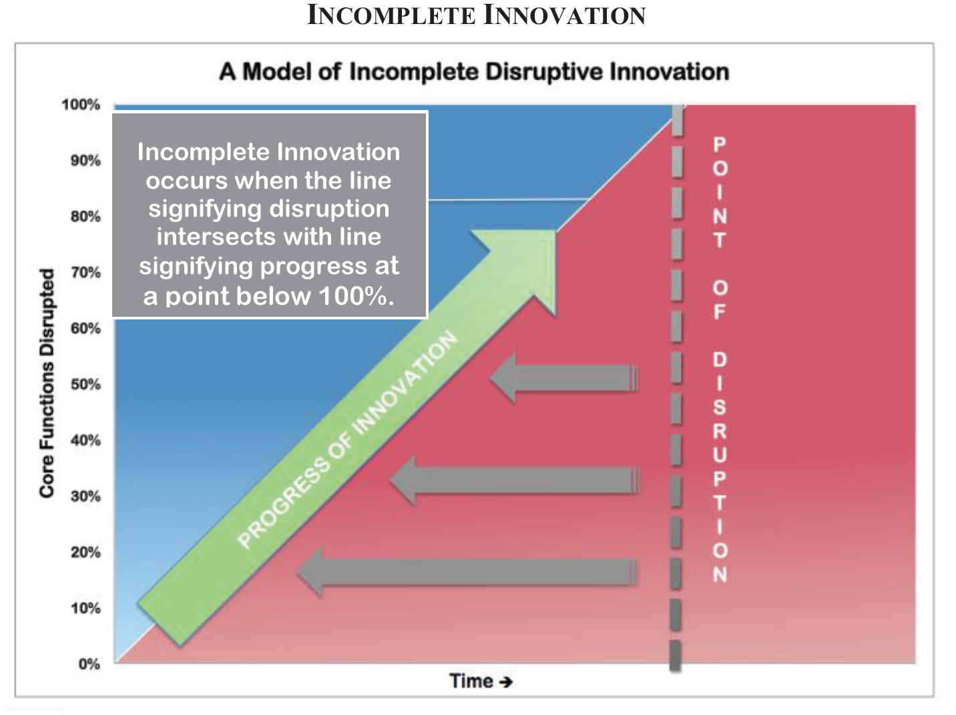
Premature Disruption of Legal Services
Incomplete Innovation
When disruption has occurred, but the innovator has not disrupted at least one core function, there has been an “Incomplete Innovation”
Brian Sheppard, Premature Disruption of Legal Services, 2015 Michigan St. L. Rev. 1797

Slide 37
Trojan horse

Slide 38
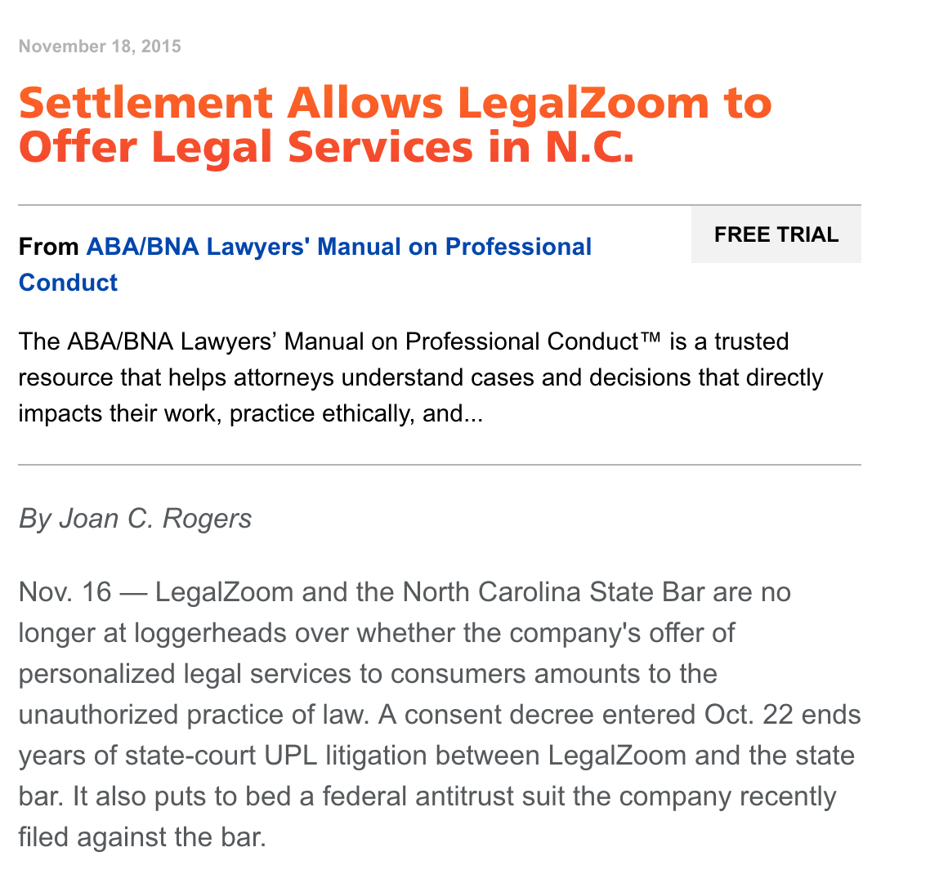
Lawyer Regulators…
Notes:
Explain difference in proactive

Slide 40
Questions?
Thank you!
CodeX website:
codex.stanford.edu
Executive Director:
Roland Vogl
rvogl@law.stanford.edu
(650) 723-8532

