Slide 1
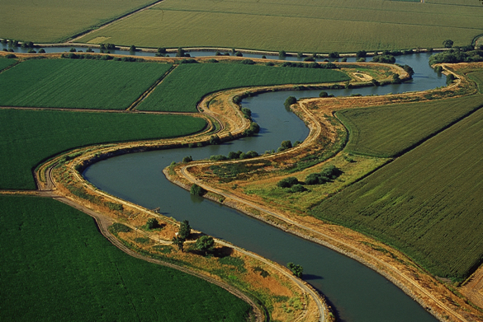
Different Views of the Sacramento-San Joaquin Delta: How We See California’s Most Important Ecosystem NOCALL Spring Institute April 13, 2013
David Sandino
Senior Staff Counsel, DWR
(916) 653-7084 dsandino@water.ca.gov

Slide 2
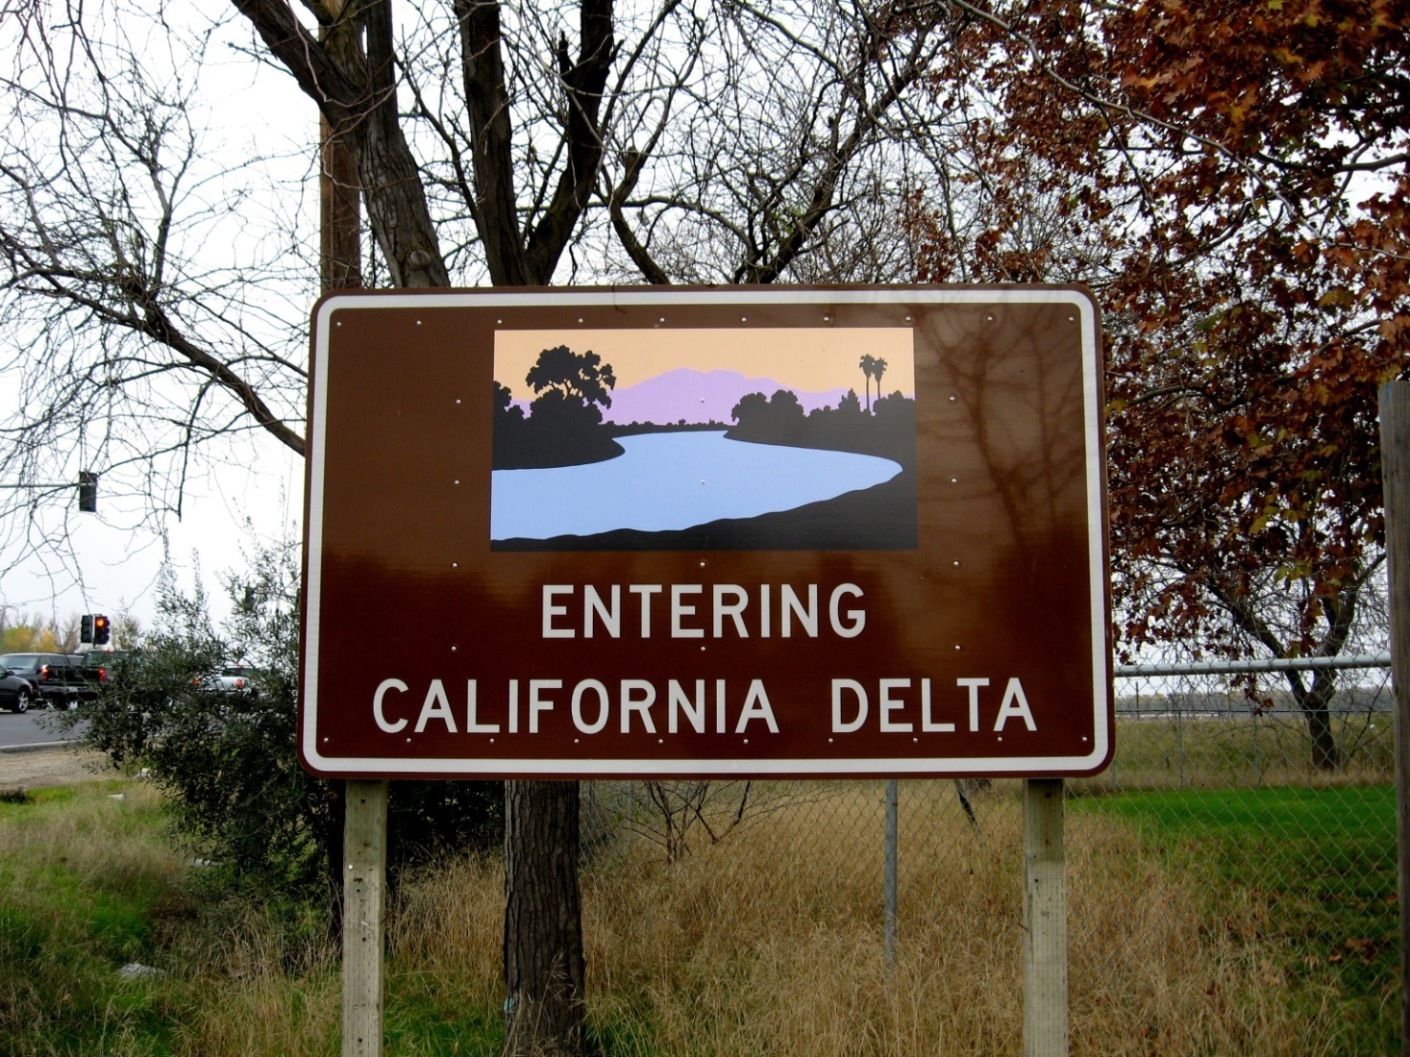

Slide 3
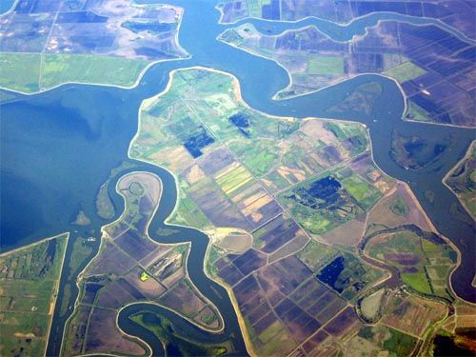
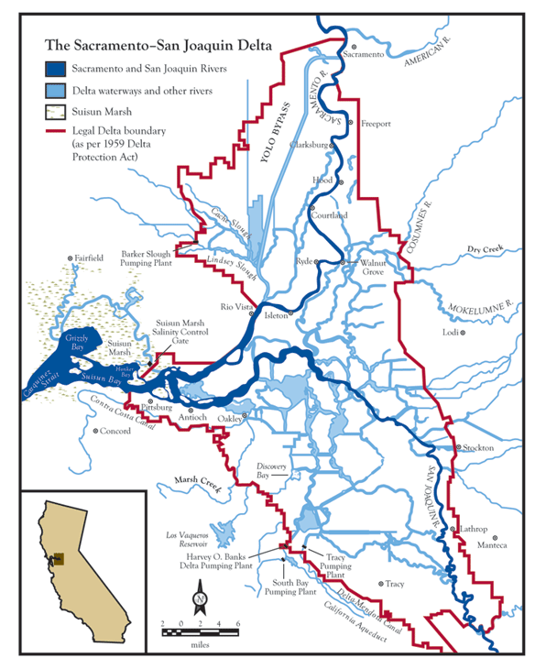
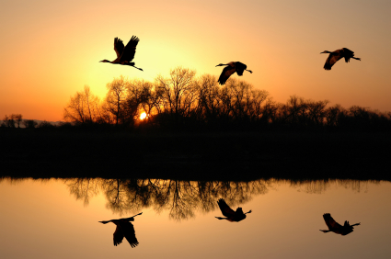

Slide 4
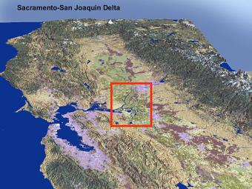
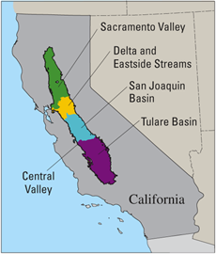
What do we mean
by the Delta?

Slide 5
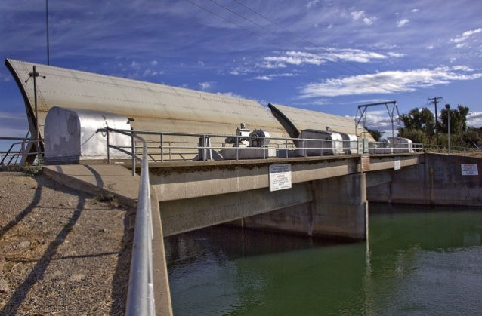
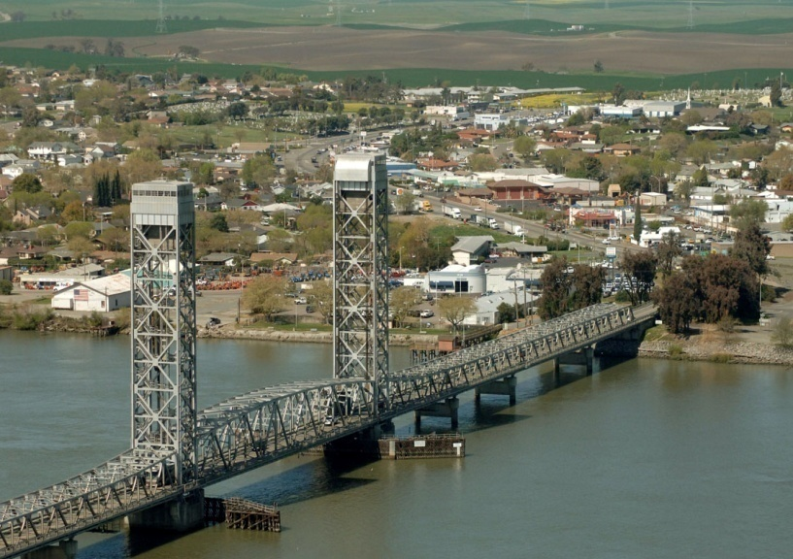
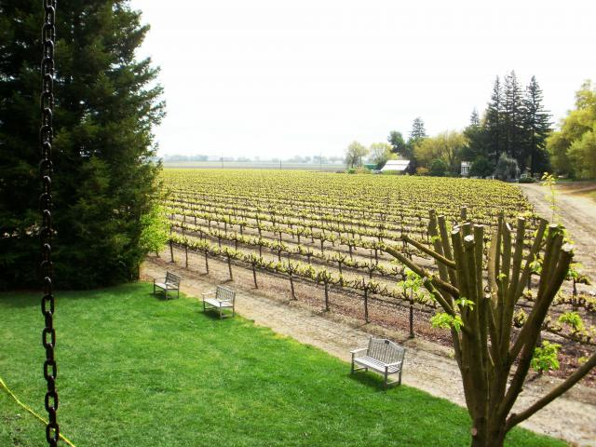
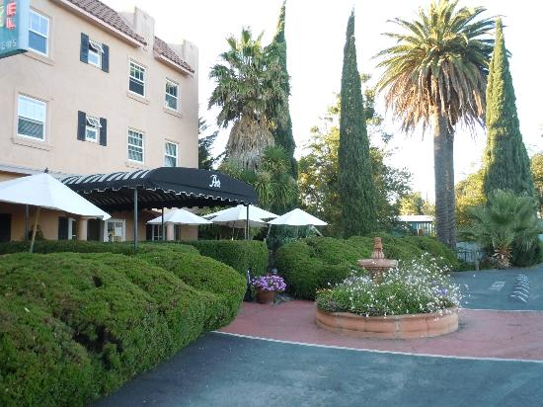
Why is the Delta Important?

Slide 6
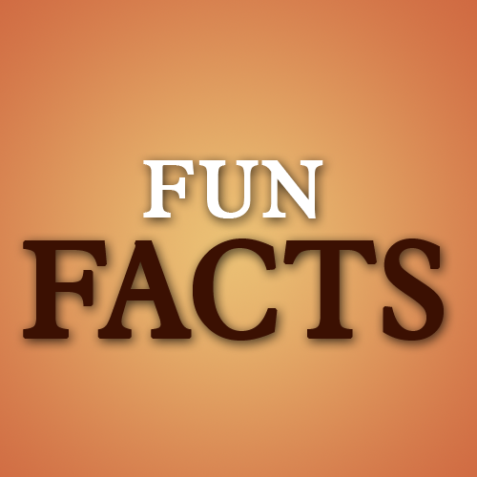
Delta Fun Facts!
738,000 acres
1,100 miles of levees
700 miles of waterways
57 leveed islands
500 species
Supplies water for 25 million people and farms!

Slide 7
Perceptions of the Delta

Slide 8
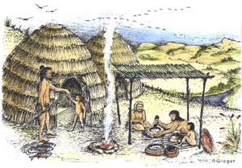
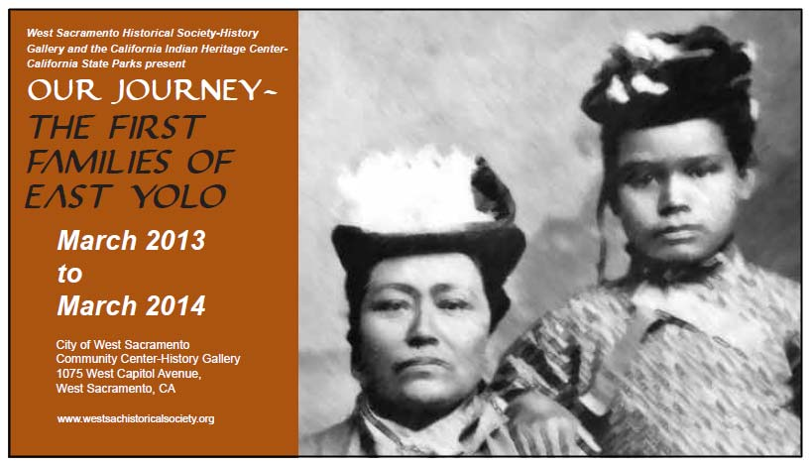
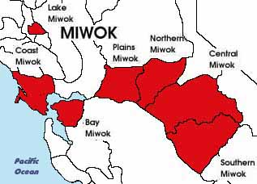
Home to Native Americans

Slide 9
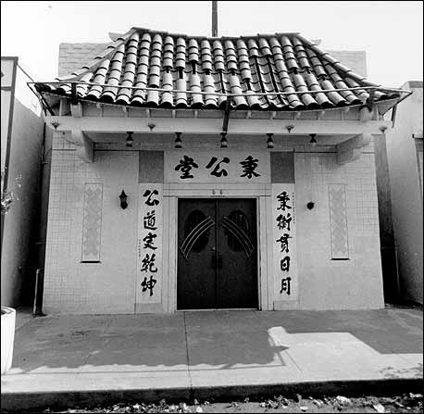
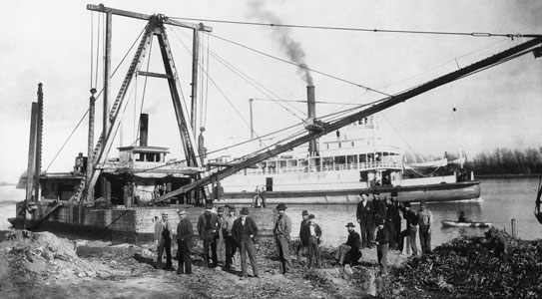
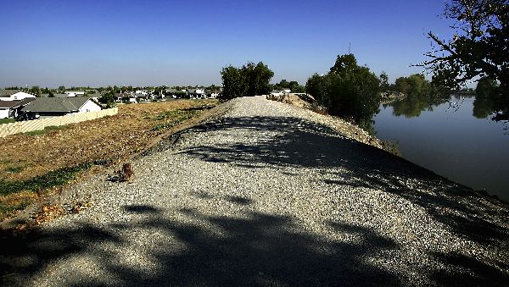
19th Century History

Slide 10
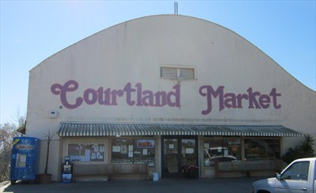
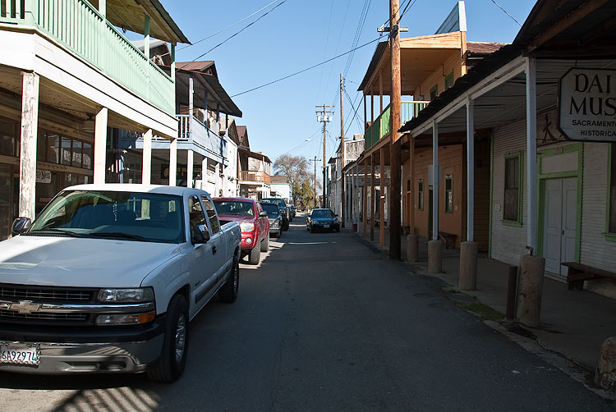
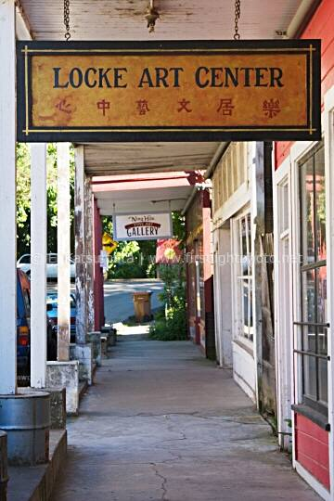
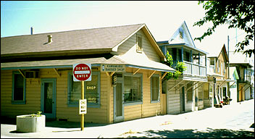
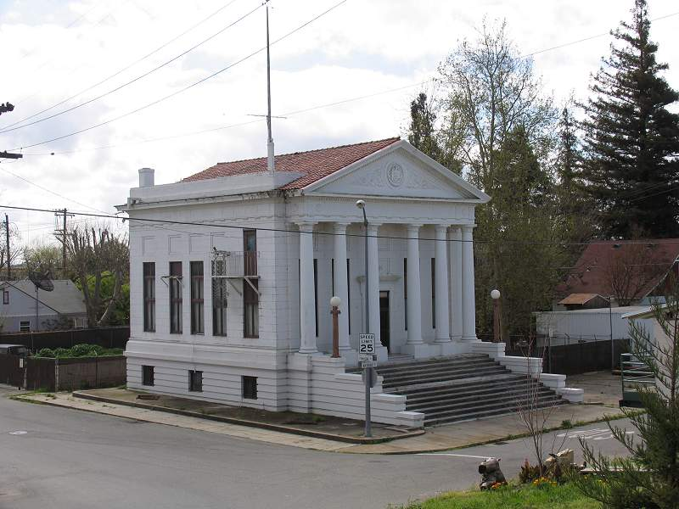
Delta Communities

Slide 11
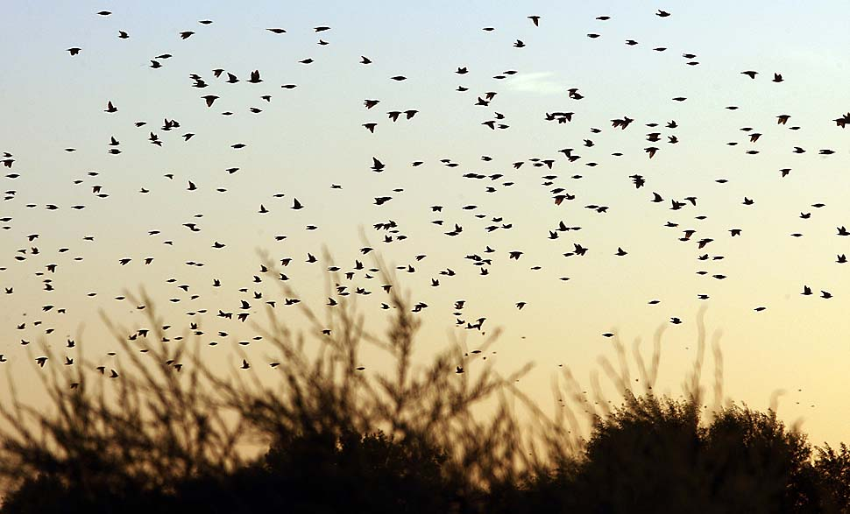
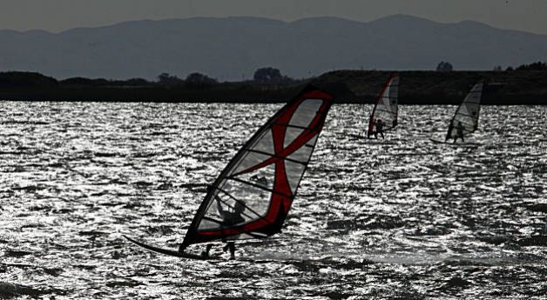
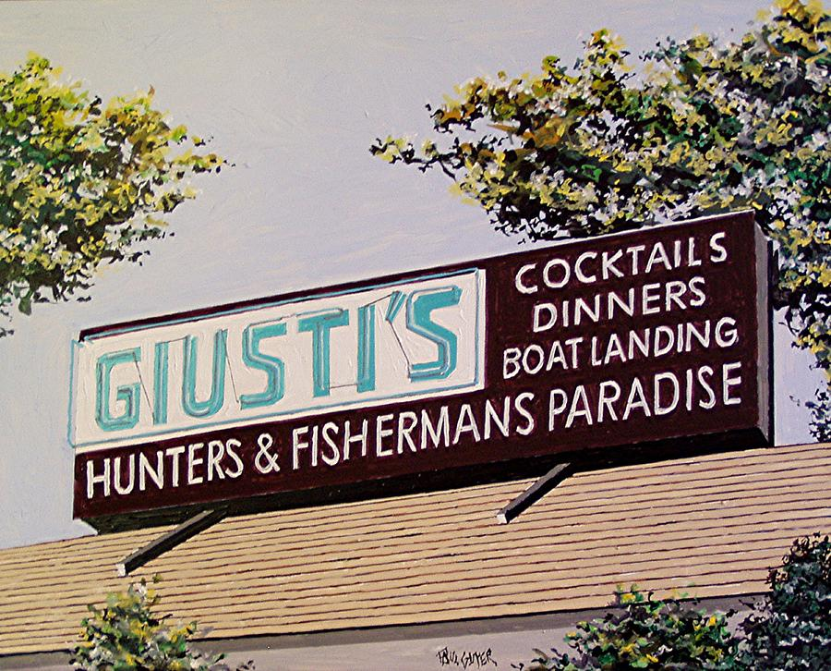
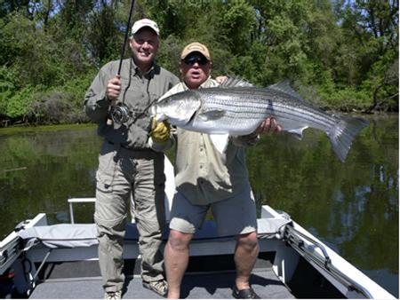
Recreation

Slide 12
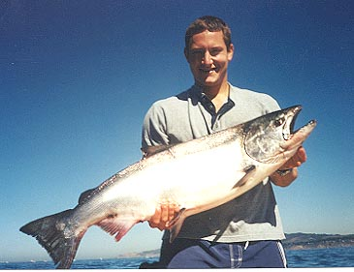
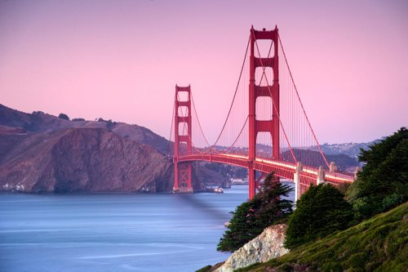
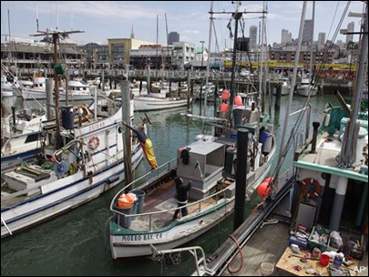
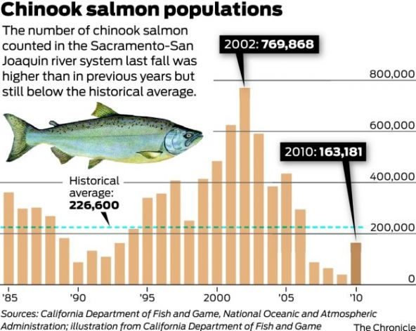
Commercial Fishing

Slide 13
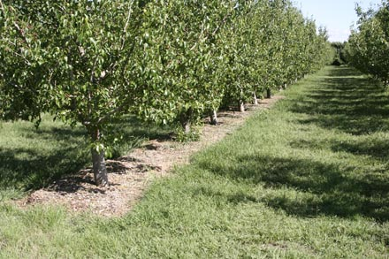
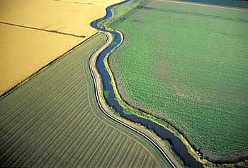
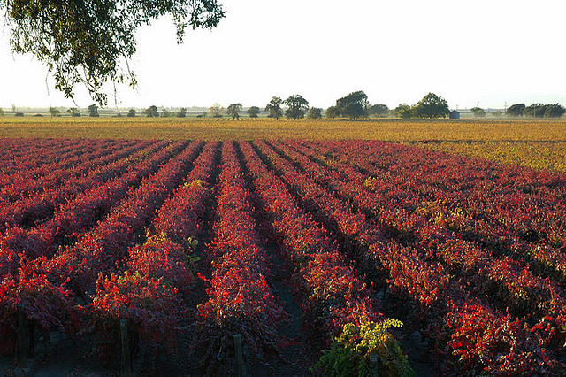
Agriculture

Slide 14
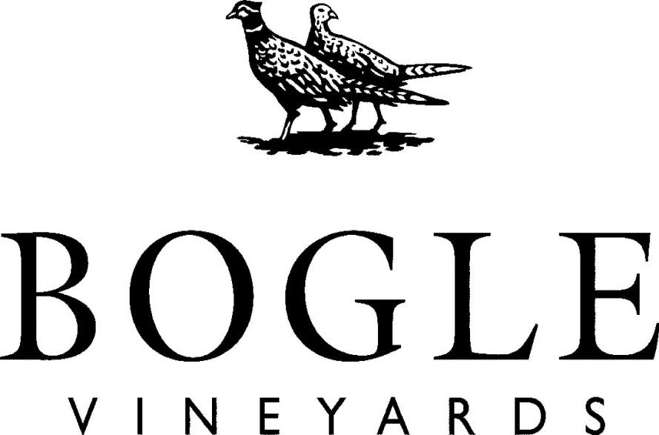
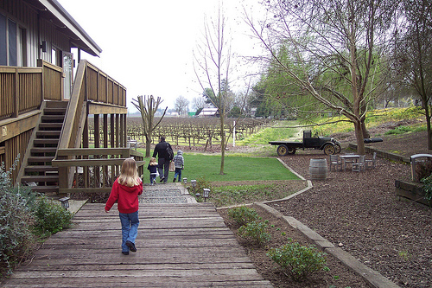
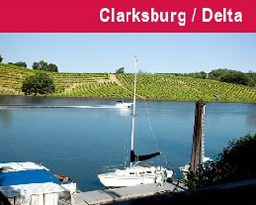
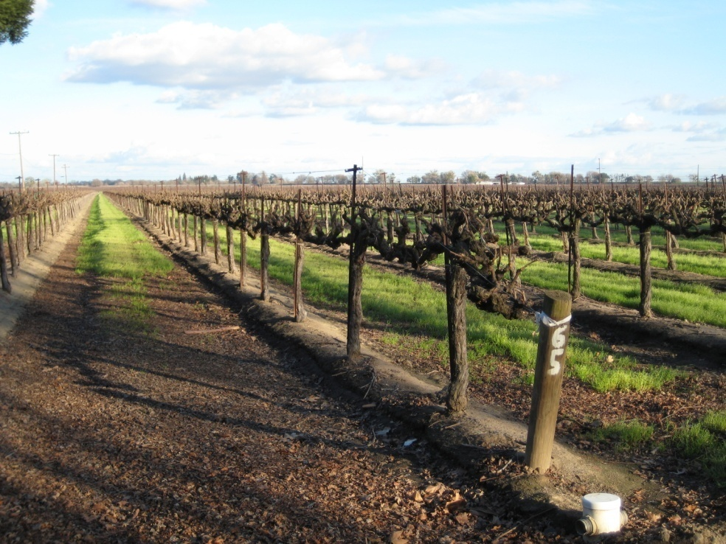
Wineries

Slide 15
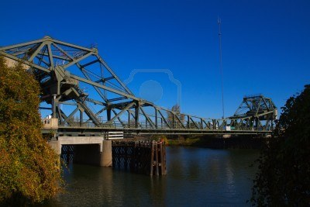
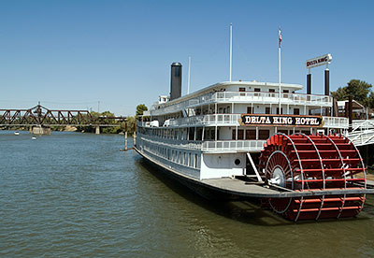
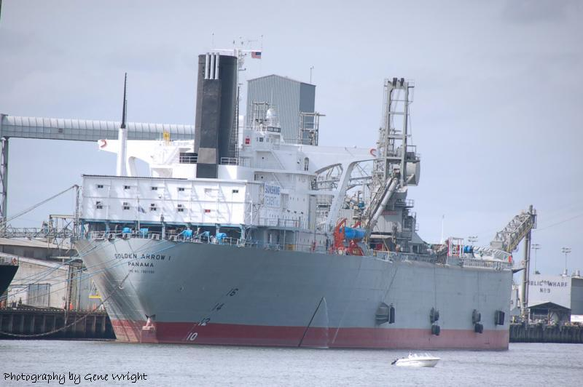
Transportation & Commerce

Slide 16
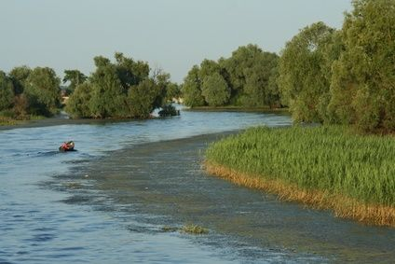
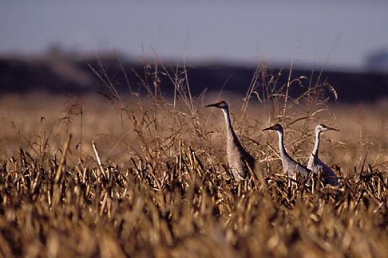
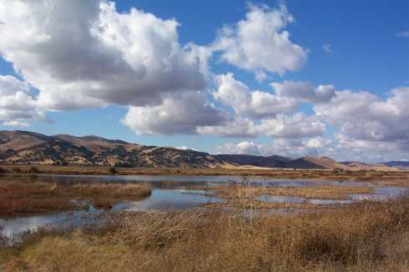
Natural Environment

Slide 17
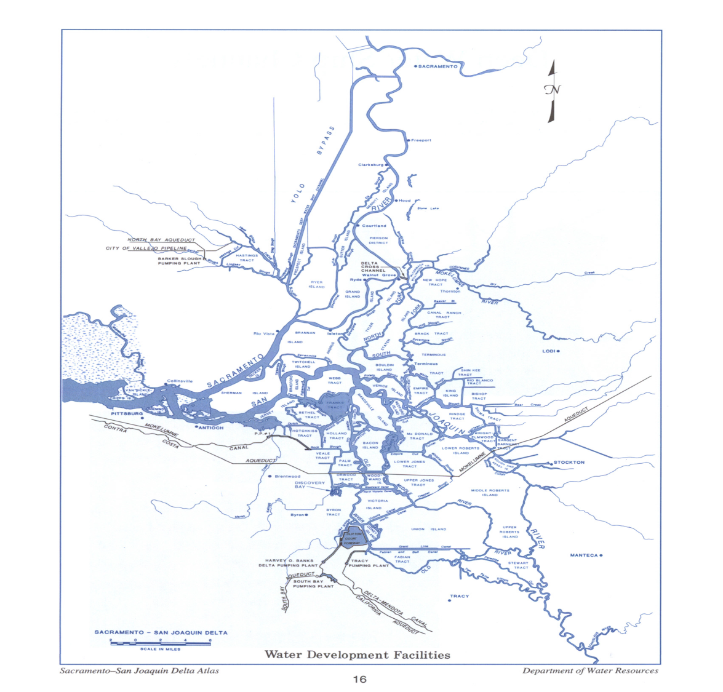
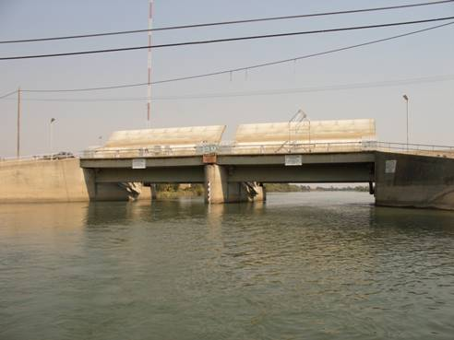
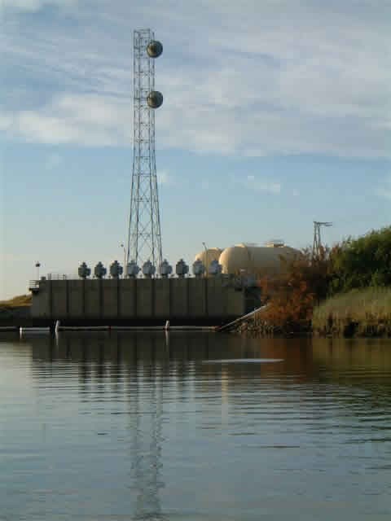
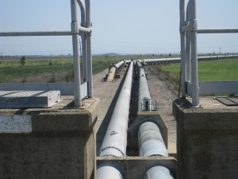
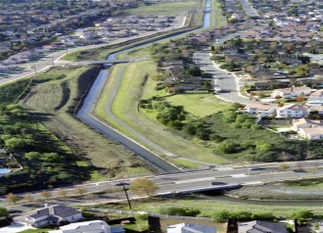
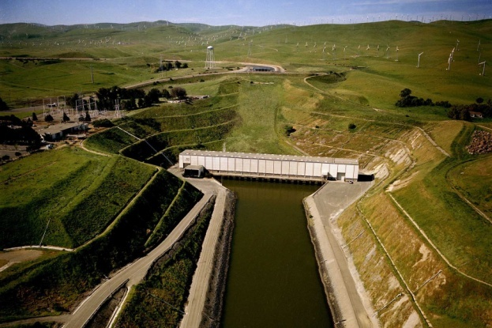
Water Engineering

Slide 18
Upstream Water Users

Slide 19
Delta Export Water Users

Slide 20
Political Hotspot

Slide 22
Jones Tract Flooding-2004

Slide 23
Delta Smelt Index

Slide 26
“Actually so much water is moved around California by so many different agencies that maybe only the movers know on any given day whose water it is”

Slide 27
Aerial Photography

Slide 28
Infrared Aerial Photography

Slide 29
Sacramento Delta Deep Water Ship Channel
by Dennis Ziemienski

Slide 33
Wayne Thiebaud (b. 1920)
Delta Water

Slide 34
Futurists

Slide 35
Climate Change & the Delta

Slide 36
Eco-Friendly Vision

Slide 38
Delta Wetlands Project

Slide 40
Recreational Vision

Slide 42
Draft Habitat Restoration Goals
Accelerated habitat restoration in the Delta
30,000 acres of aquatic habitat in the first 15 years.
More than 100,000 acres of restored and protected habitat.
Notes:
Habitat Restoration Goals include:
10,000 Acres Restored Floodplain
65,000 Acres Restored Tidal Habitat
20 Levee Miles Restored Channel Margin
5,000 Acres Restored Riparian Woodland
Grassland Protected (8,000 Acres) and Restored (2,000 Acres)
Other Restoration (Vernal Pool, Nontidal Marsh, Alkali Seasonal Wetland Complex) 1,250 Acres

Slide 43
Draft Dual Conveyance with Pipeline/Tunnel
Conveyance facility would feature:
Gravity flow
Three proposed intakes of 9,000 cfs capacity
Three state-of-the-art fish screens
A 925-acre Intermediate Forebay for temporarily storing the water pumped from the river
Two tunnels 35 miles long under th eDelta
Preliminary Draft – Subject to Change
Notes:
Based on Alternative 4, Conveyance facility would feature:
Gravity Flow tunnel system
Gravity Flow Benefits Include:
Reduced energy consumption and greenhouse gas emissions
Installation of fewer transmission lines
Three proposed intakes and three proposed pumping plants for a total of 9,000 cfs capacity
Three state-of-the-art fish screens held to performance standards to protect passing fish
A 925-acre Intermediate Forebay for temporarily storing the water pumped from the river

Slide 44
Thank You For the Dialogue!

