Slide 1
Knowledge.
Insight.
Solutions.

Slide 2
Agenda
How we got here?
Discover PLUS
Q&A
Notes:
Today we will go through

Slide 3
Educating the legal community since 1933
Notes:
Today we will go through

Slide 4
How we got here

Slide 5
The in
All Inclusive
IP Authentication
Searchable Forms
Improved Search Functionality
My Folders and Saved Searches
How we got here

Slide 7
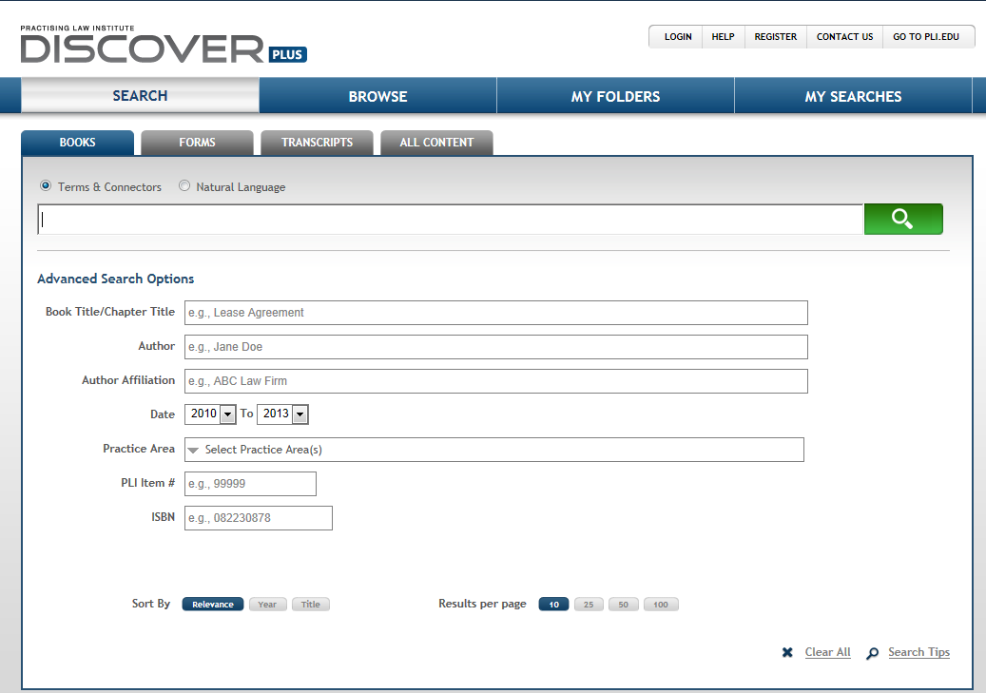

Slide 8
"disclosure requirements" /4 (sec or "securities and exchange commission" or "securities & exchange commission")

Slide 9
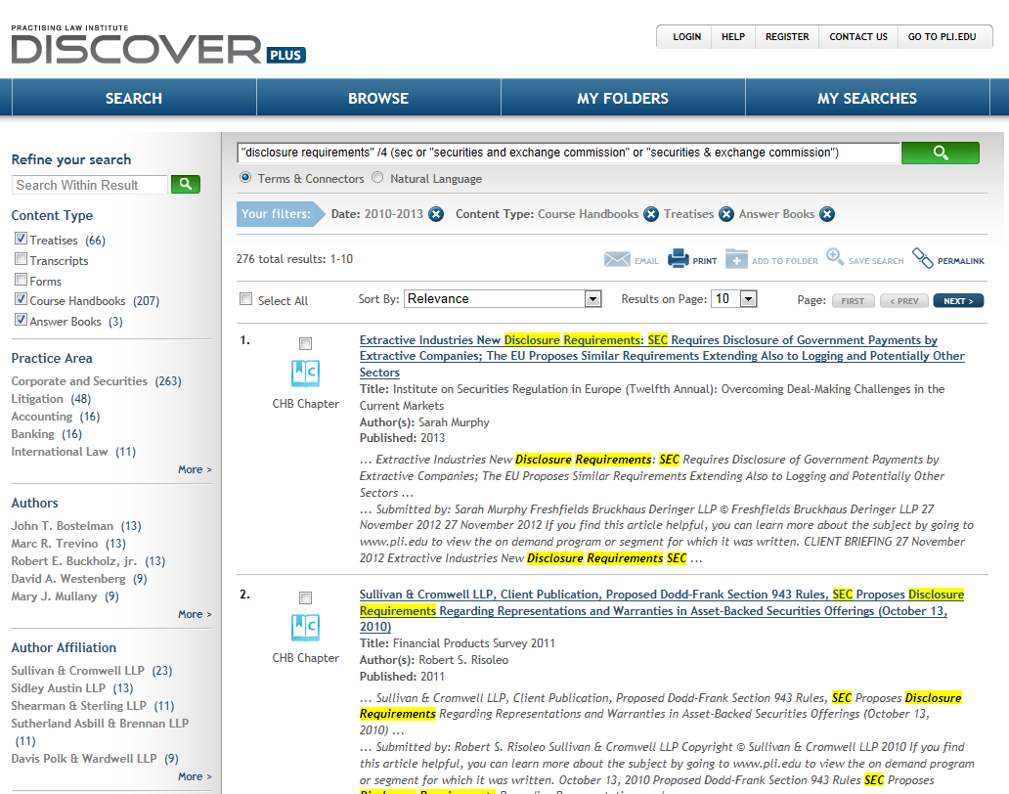
Search Results

Slide 10
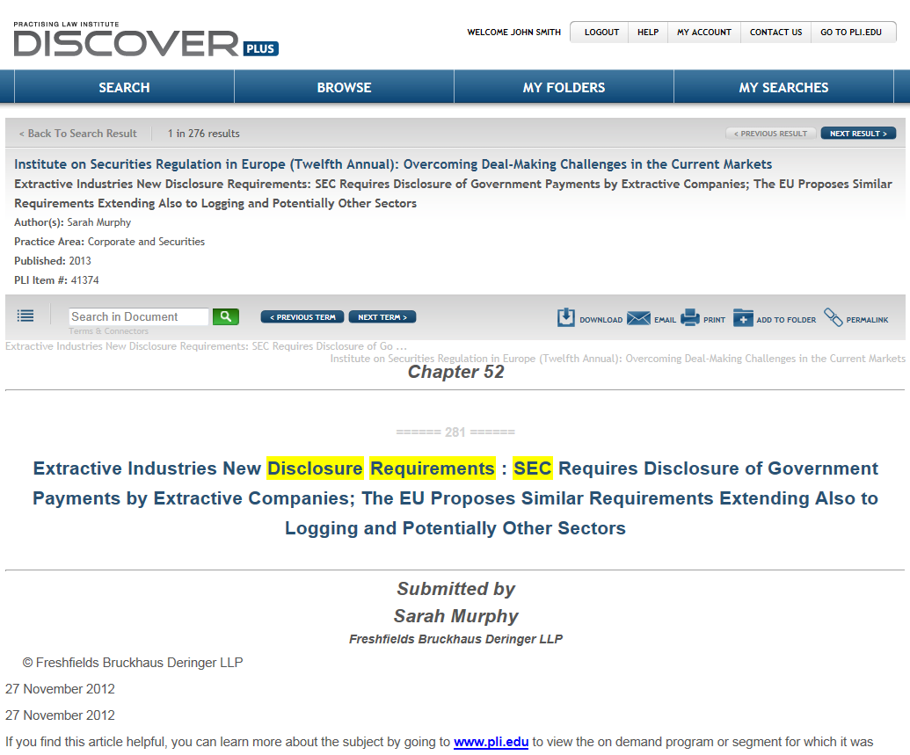
Chapter Record

Slide 11
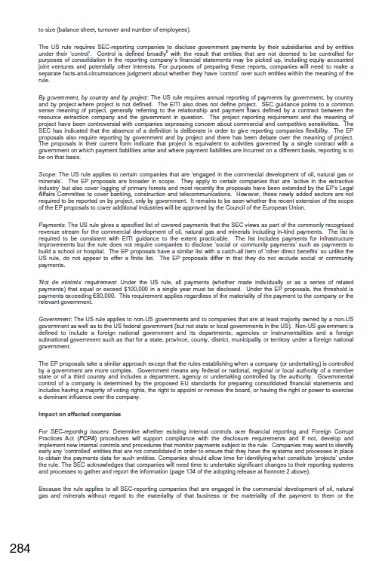
PDF

Slide 12
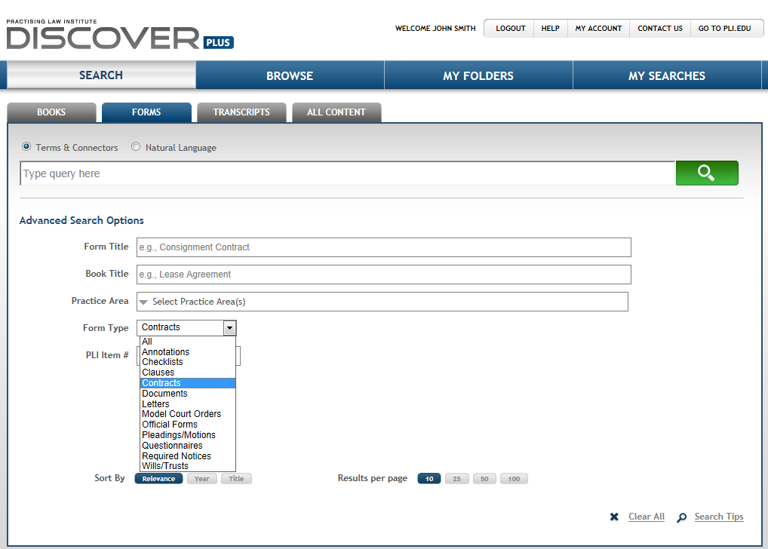
Forms Search

Slide 13
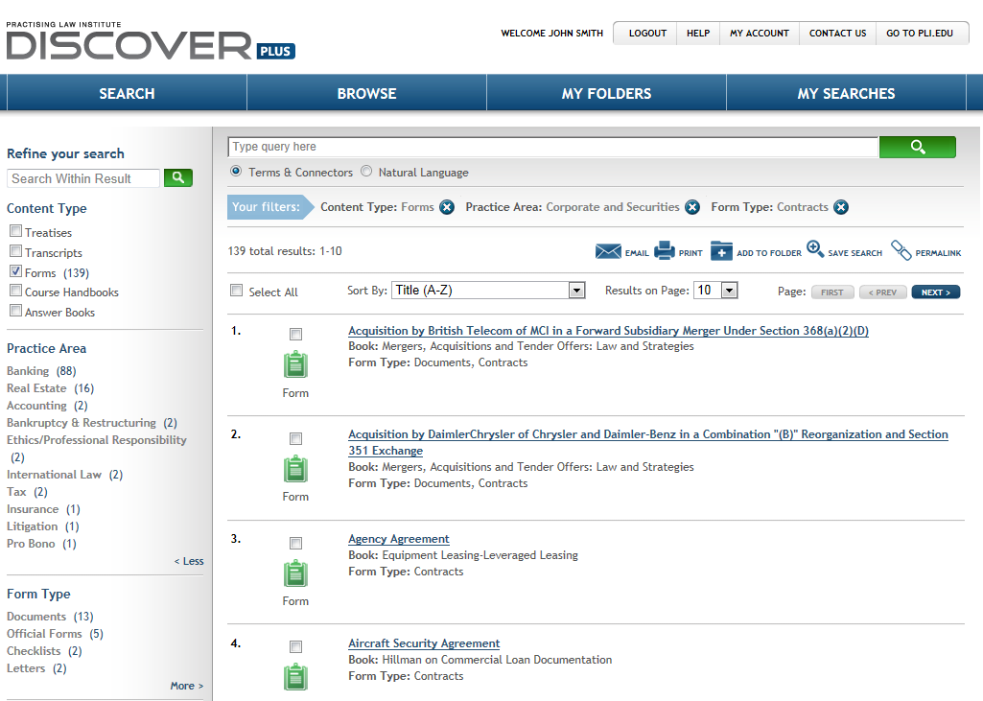
Search Results

Slide 14
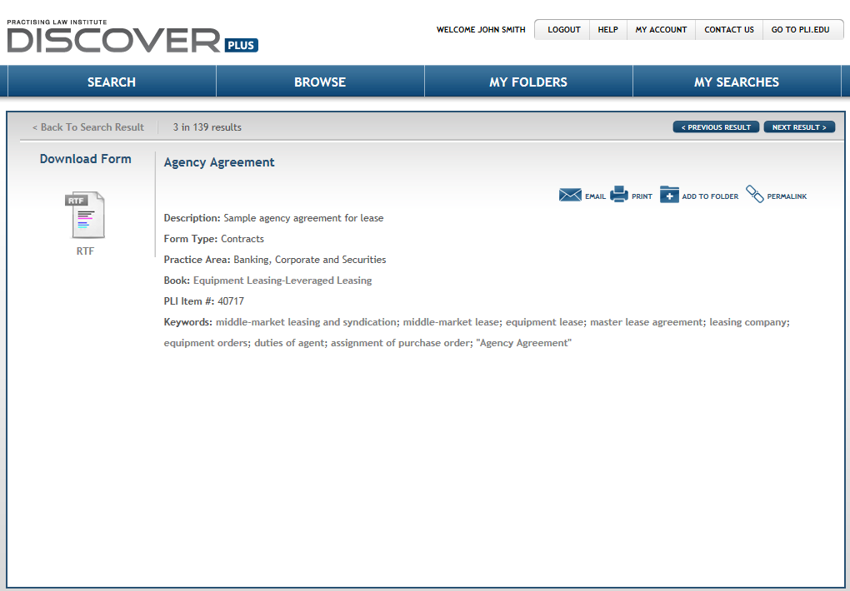
Form Record

Slide 15
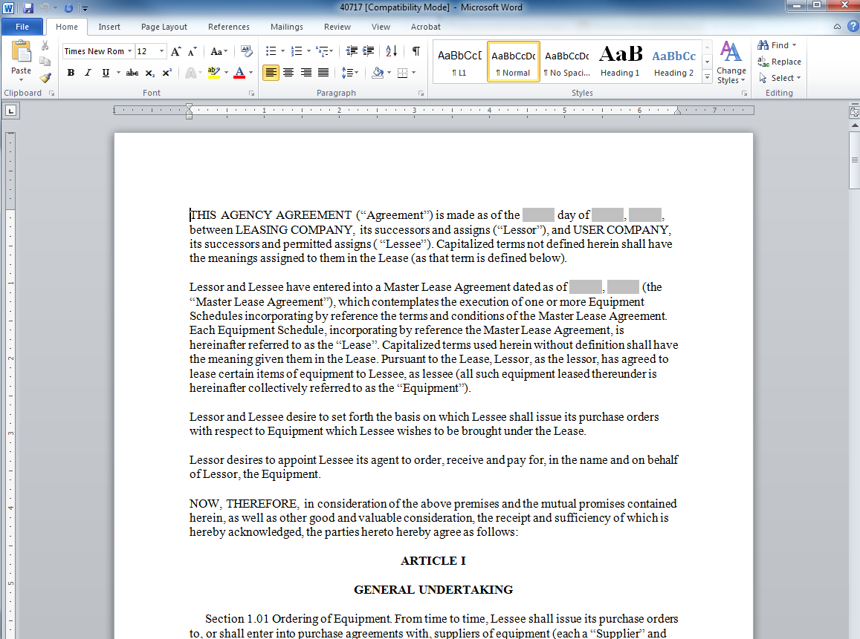
RTF

Slide 16
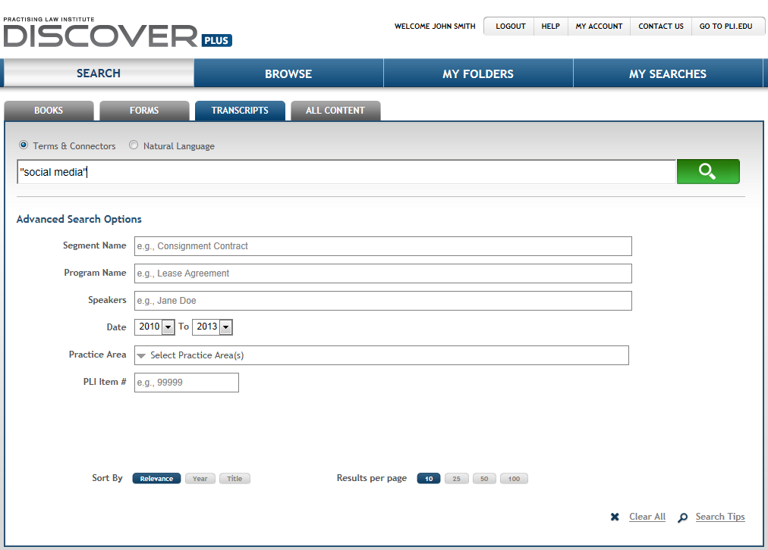
Transcripts Search

Slide 17
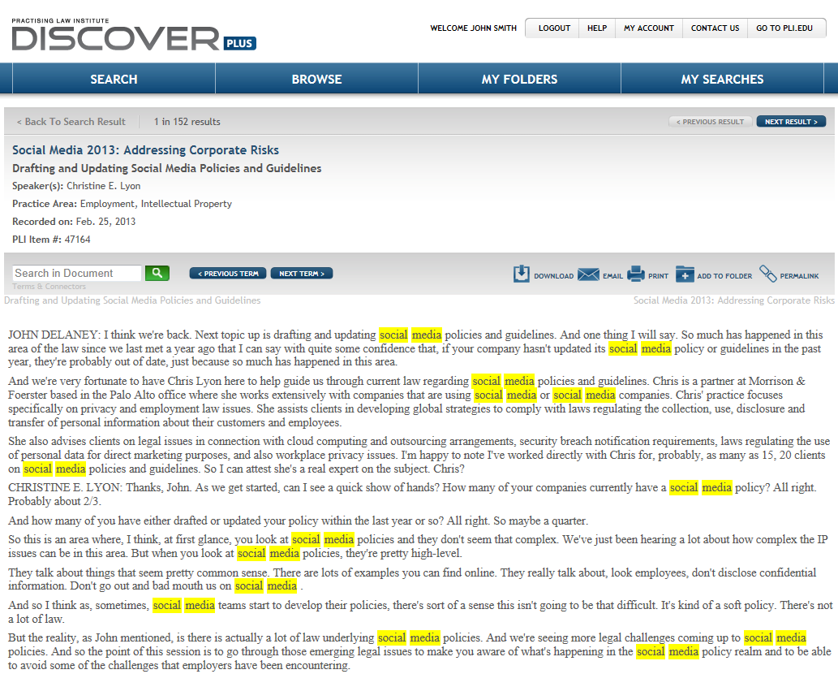
Transcripts Record

Slide 18
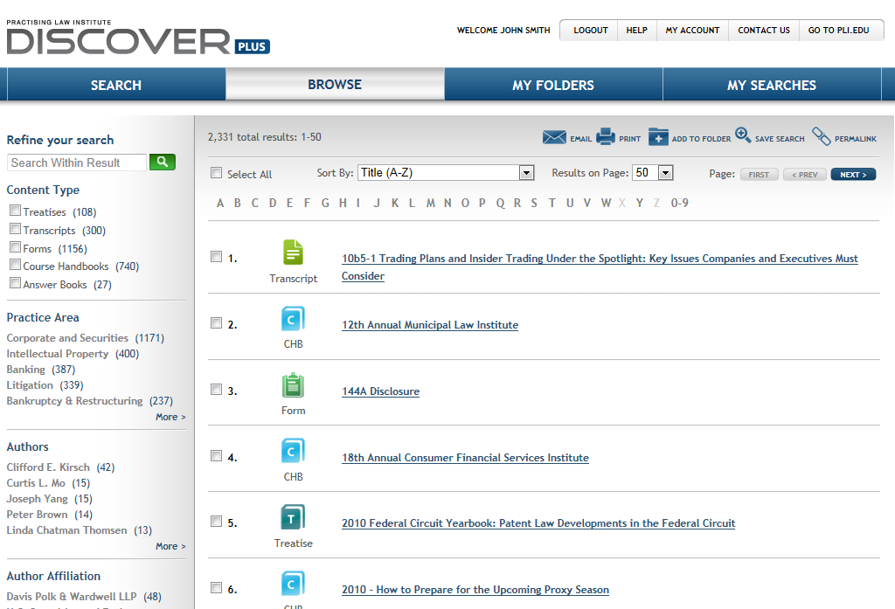
Browse

Slide 19
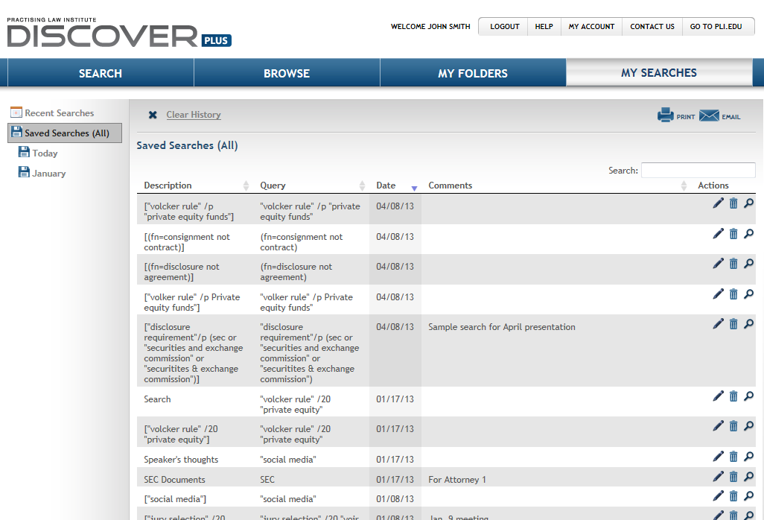
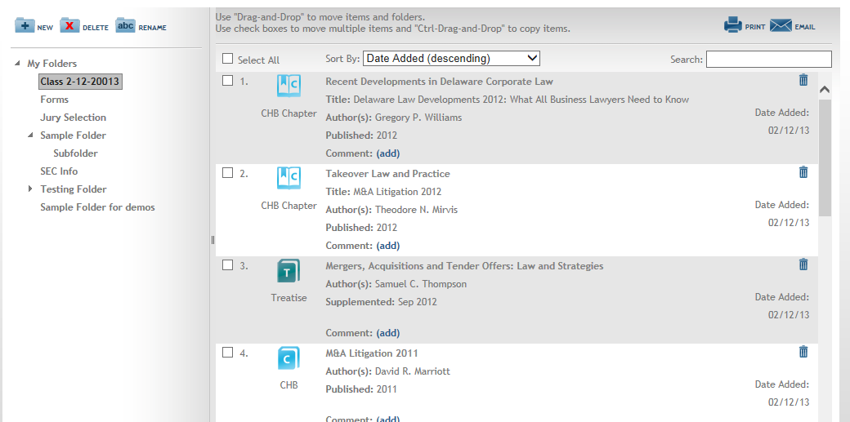
My Folders
My Folders

Slide 20
My Searches

Slide 21
Questions?

Slide 22
Contact:
Alexa Robertson: arobertson@pli.edu
Notes:
Today we will go through

