Slide 1
eBooks, Formats, and Devices A report from the trenches April 12, 2013

Slide 2
Introductions
Denise Davis
Amy Calhoun
Deputy Director
Sacramento Public Library
ddavis@saclibrary.org
Virtual Branch Coordinator
Sacramento Public Library
acalhoun@saclibrary.org
Notes:
Project Overview

Slide 3
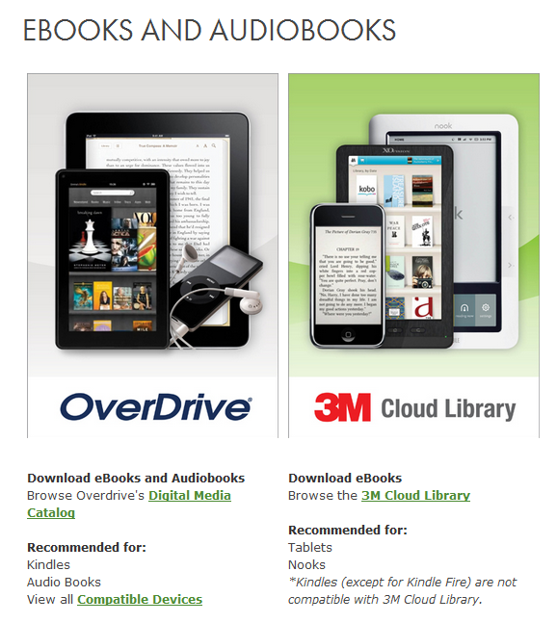
Notes:
How did we get here?

Slide 4
Challenges
Formats
EPUB
Kindle (proprietary)
Blio (proprietary)
100+ consumer devices
Lending
DRM
Software/App Installation
10+ steps vs. one-click buying

Slide 5
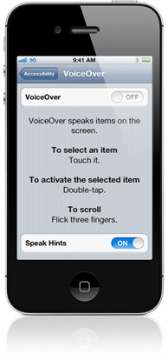
What is Hearing eBooks?
Circulating accessible eReaders
18 iPod Touch devices
40+ eBooks per iPod
Notes:
Project Overview

Slide 6
Background
California State Library
Selects Sacramento Public Library for an LSTA grant
Barnes & Noble
Partners with Sacramento Public Library
Sacramento Public Library
250+ Nooks
470+ Total Waiting List
3000+ Circulations
Assistance with Device Set-up
Training Sessions for Public
Notes:
How did we get here?

Slide 7
National Federation of the Blind
“With more than 50,000 members, the National Federation of the Blind is the largest and most influential membership organization of blind people in the United States.” - nfb.org
October 2011
Formal complaint
issued by the National
Federation of the Blind.
Notes:
National Federation of the Blind issued a formal complaint regarding the accessibility of the Nook eReaders.

Slide 8
Department of Justice
November 2011 – August 2012
Sacramento Public Library worked with the Department of Justice to reach an agreement.
Notes:
Sacramento Public Library worked with the DOH to reach an agreement based on this complaint.

Slide 9
Agreement Details
3 year commitment
Staff ADA training is required annually
More Nooks can’t be acquired or replaced
Same titles available on both devices
18 iPod Touch devices “reserved for use by patrons with a valid borrower’s card to the Library system who are blind or others who need the accessibility features”

Slide 10
Kindle Limitations
Kindle Fire
Inaccessible touchscreen
Other Kindles
"Blind readers cannot independently navigate within a book once it is opened.” - nfb.org
Kindle Books
Limited selection of text-to-speech Kindle eBooks

Slide 11
Nook Limitations
Nook Tablet
Inaccessible touchscreen
Nook Simple Touch
No text-to-speech capability
Nook app
VoiceOver can’t read text in mobile app

Slide 12
iOS Accessibility
VoiceOver
Fully accessible touchscreen
iBooks
All iBooks are text-to-speech

Slide 13
Hearing eBooks Timeline
Oct – Nov 2012
Pilot Groups ADA Training
Dec 2012 iPod Training
Feb 2013 Launch
Notes:
Plain text slide

Slide 14
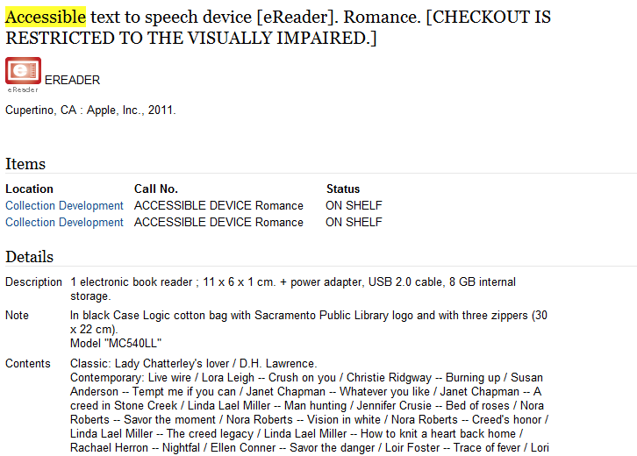
Notes:
Plain text slide

Slide 15
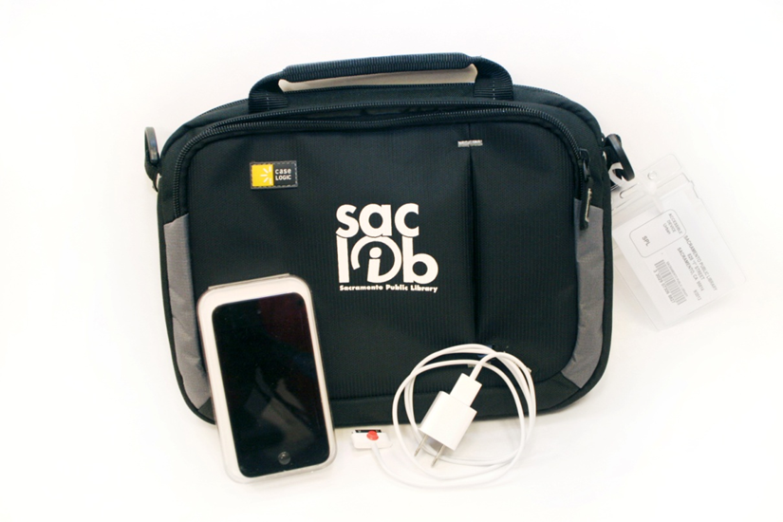
Notes:
Plain text slide

Slide 16
Visit our website:
Agreement
Lending documents
iPod VoiceOver Instructions
www.saclibrary.org/hearingebooks
Notes:
Plain text slide

Slide 17
Notes:
Ending slide

